Slide 1
Register
Login
Populate data manually OR Import Nat files
Export NAT files
Submit
Validate NAT files

Slide 2
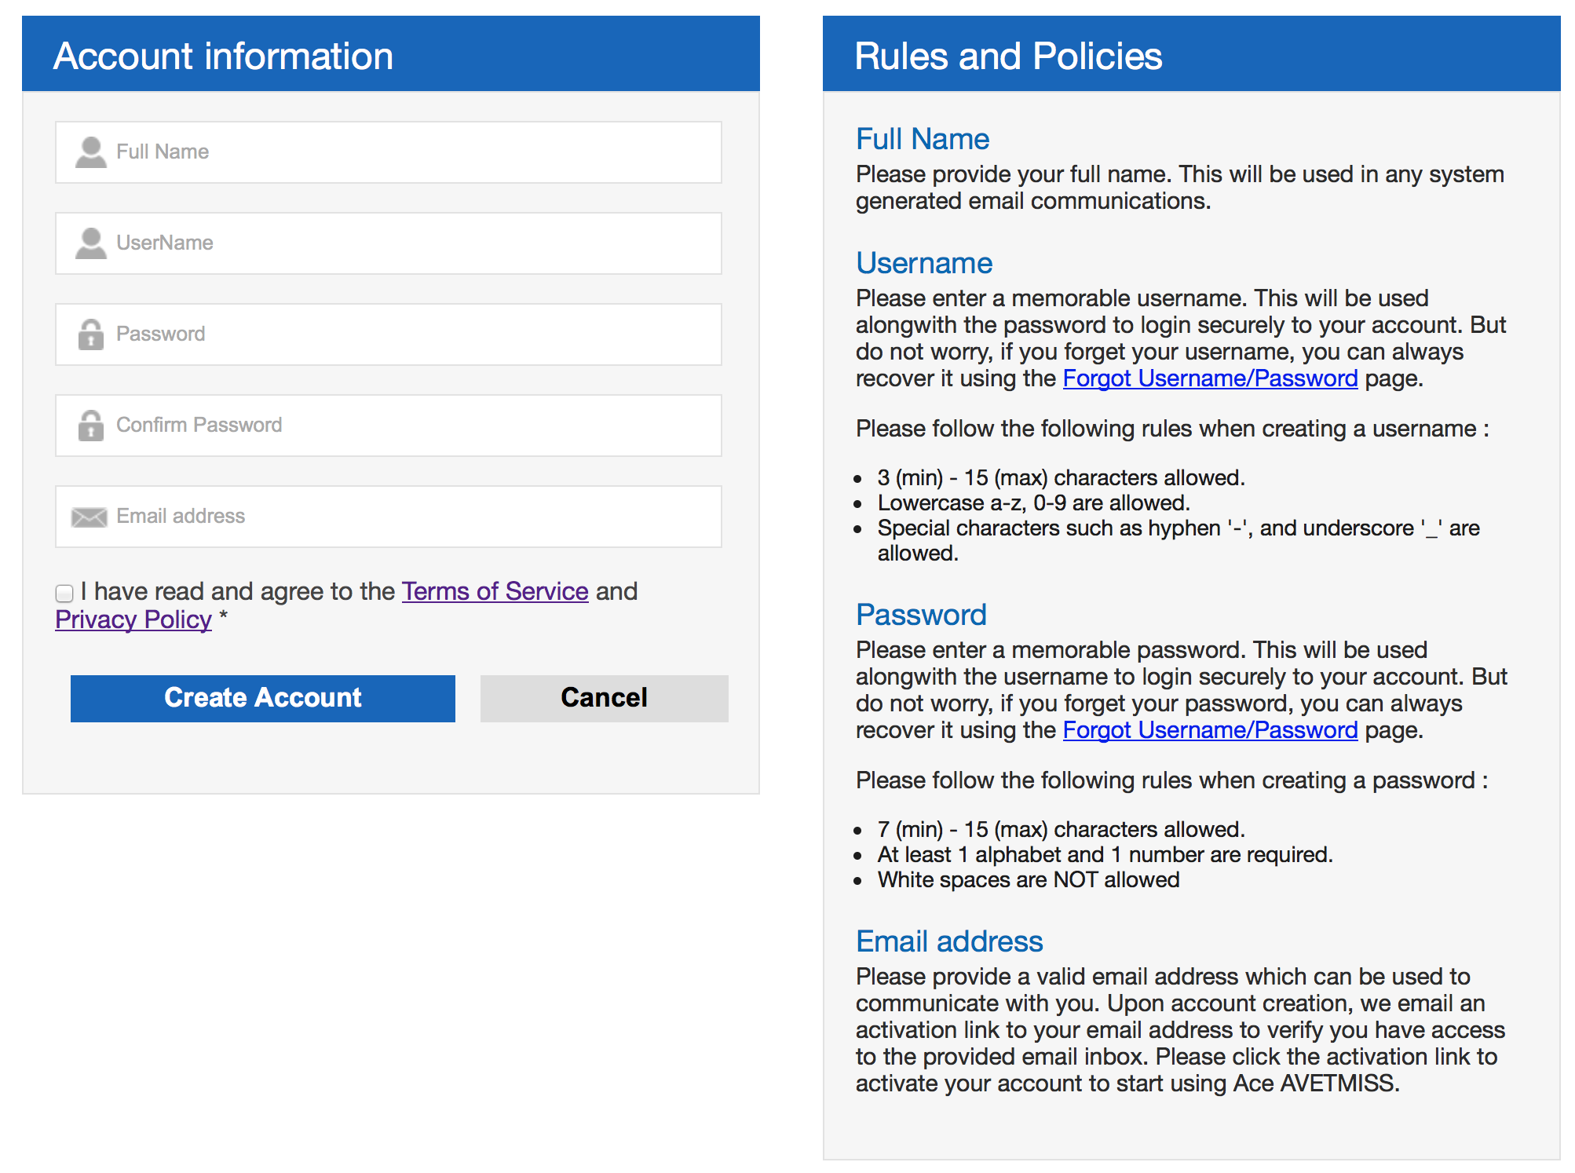
Registration
Additional text or comments here

Slide 3
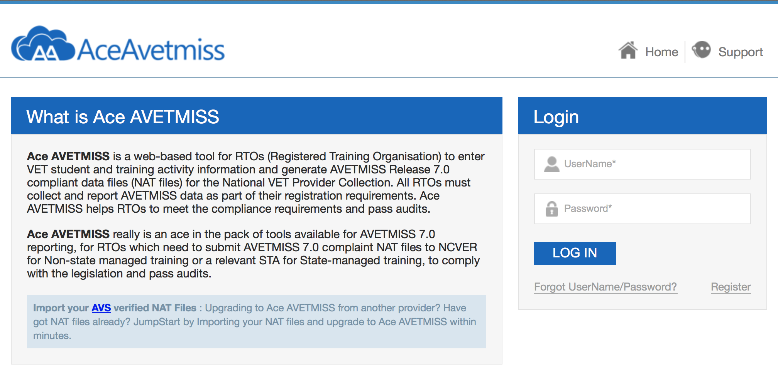
Login
Provide your registered username
Provide your password
Click Log In button after punching in your username and password
Click this link if you have forgotten either your username or your password
New user ? Register before you can login

Slide 4
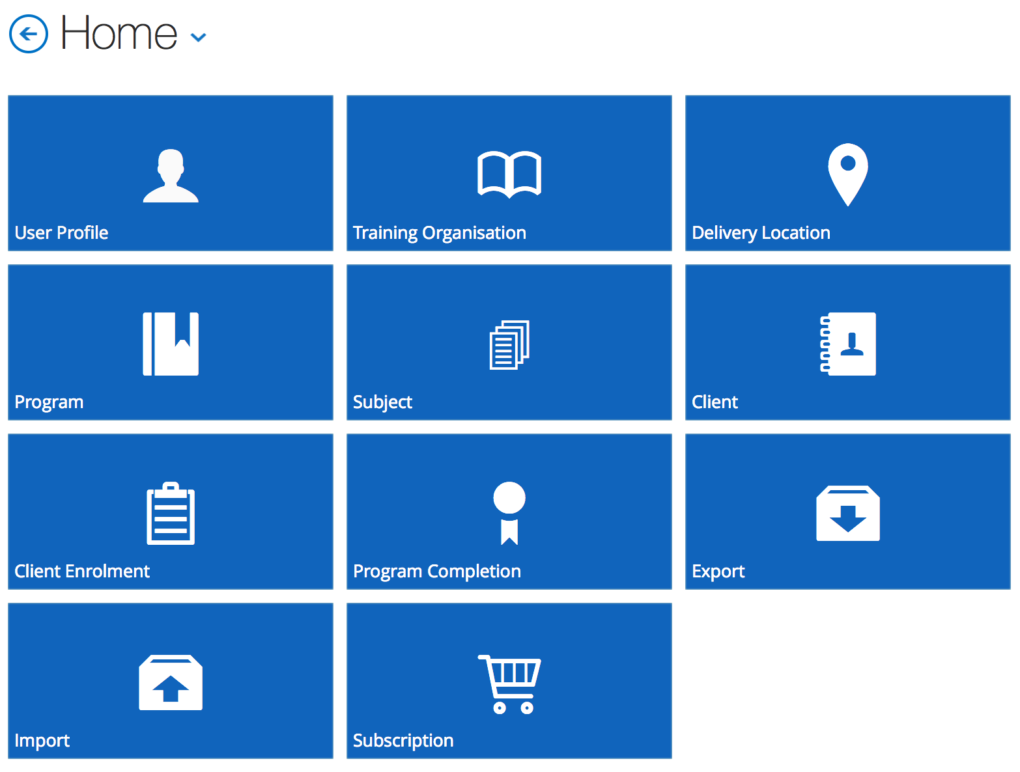
Home Screen :
Shows the global navigation menu

Slide 5
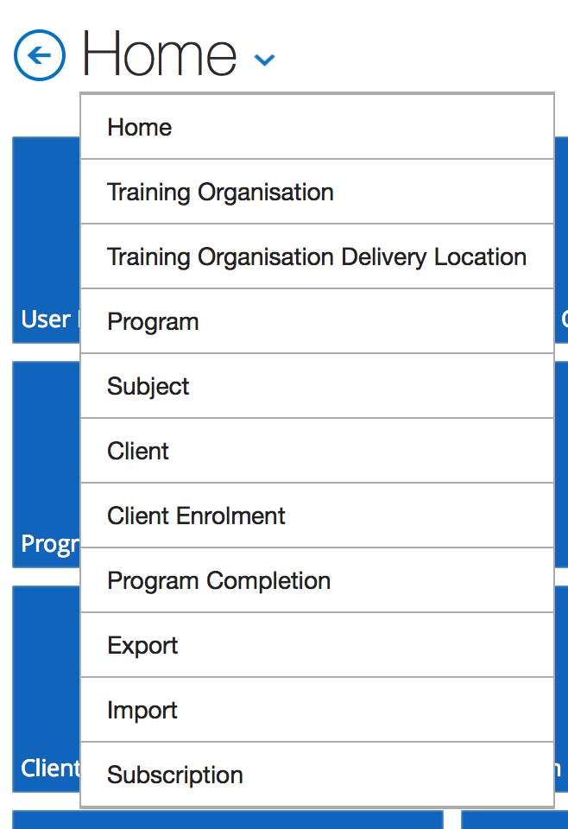
Back button. Takes you to the previous screen
Global Navigation : available in all the screens. Helps quickly navigate to any screen from any screen.

Slide 6
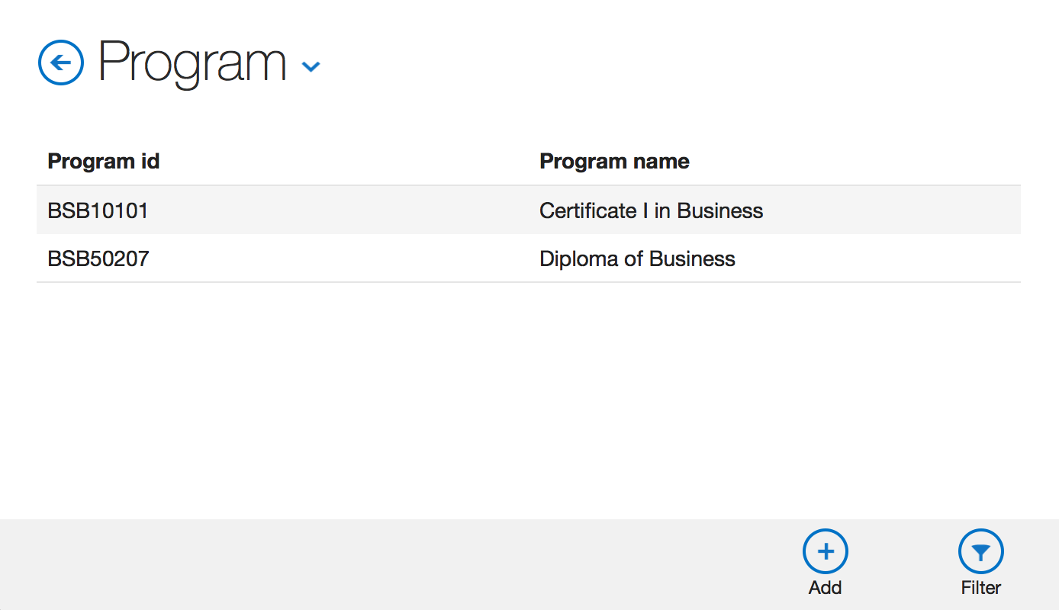
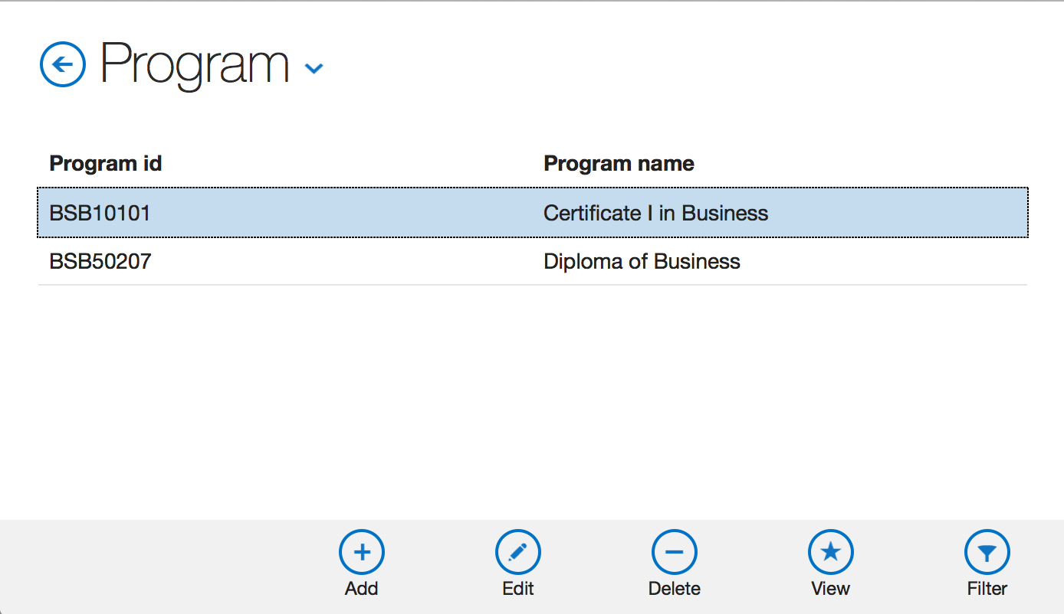
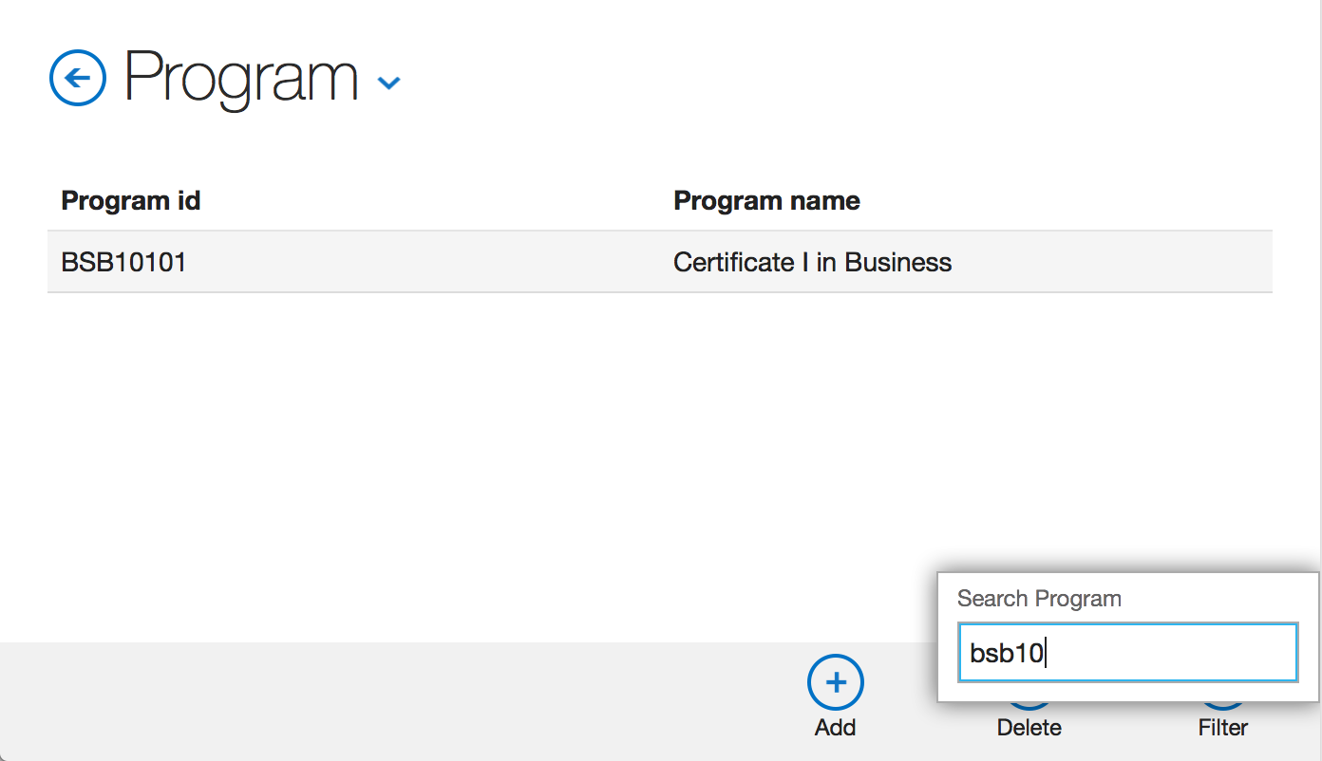
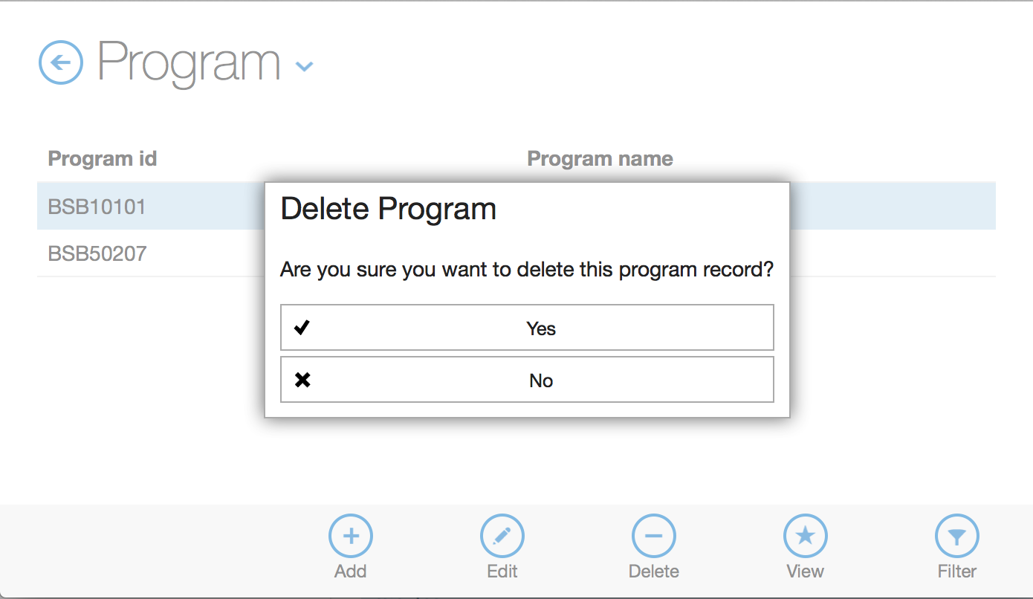
Bottom Action button bar when no record is selected
Bottom Action button bar with Edit/Delete/View buttons when a record is selected
Filter the records : click Filter button > punch in search term and hit enter
Delete a
record

Slide 7
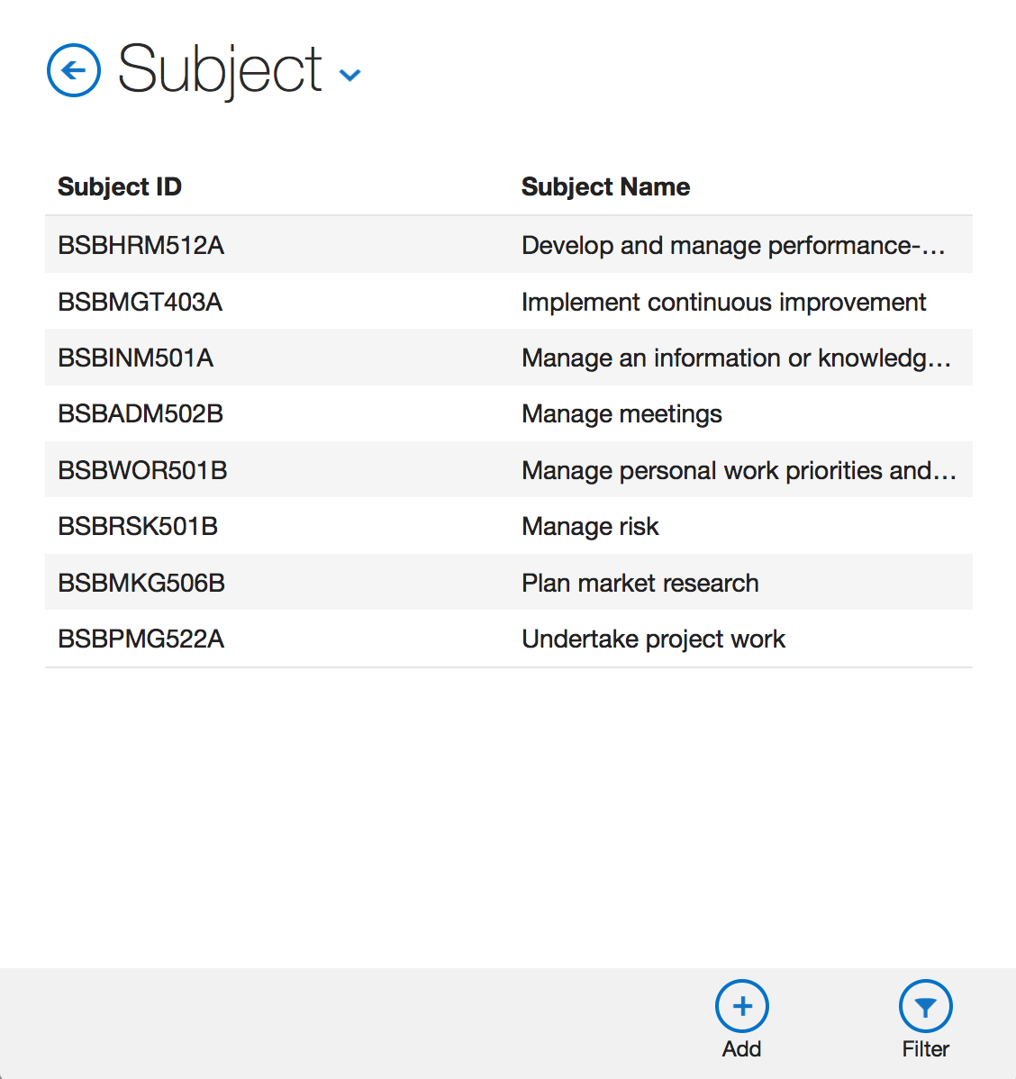
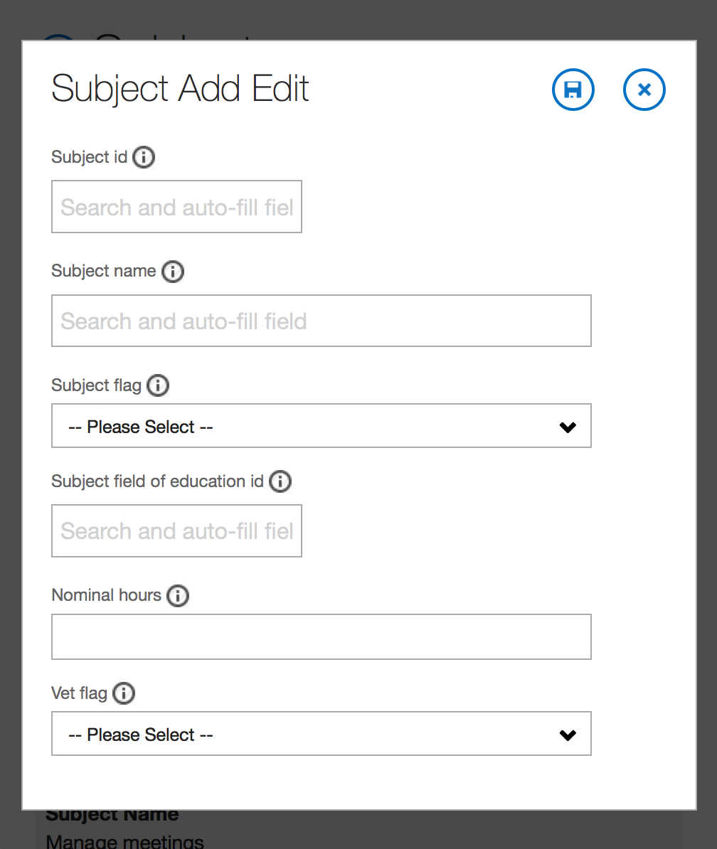
‘Search and auto-fill field’ help fill the form FASTER.
Click Add Button to create a new record

Slide 8
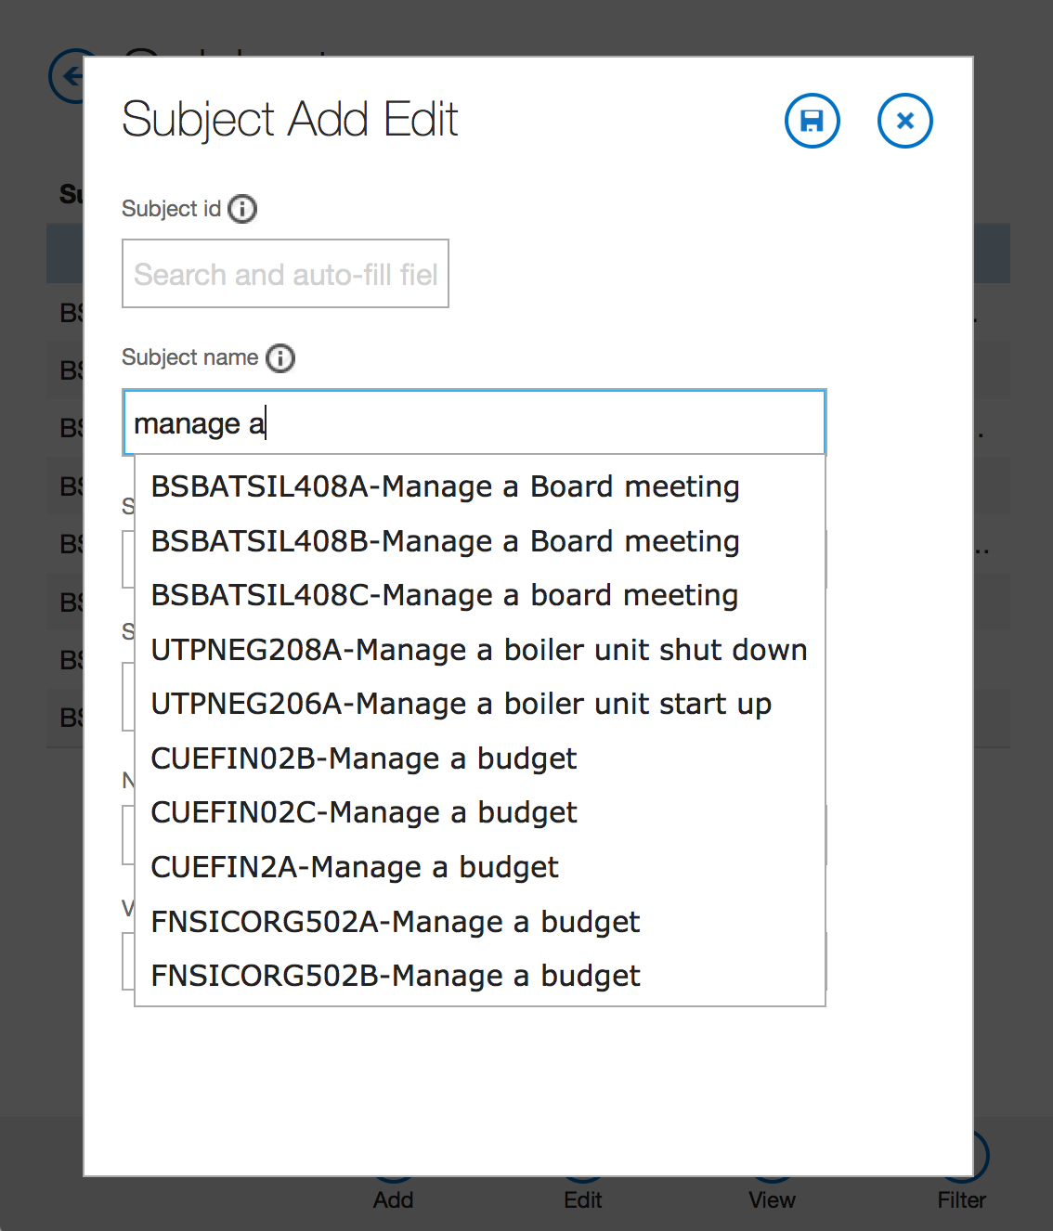
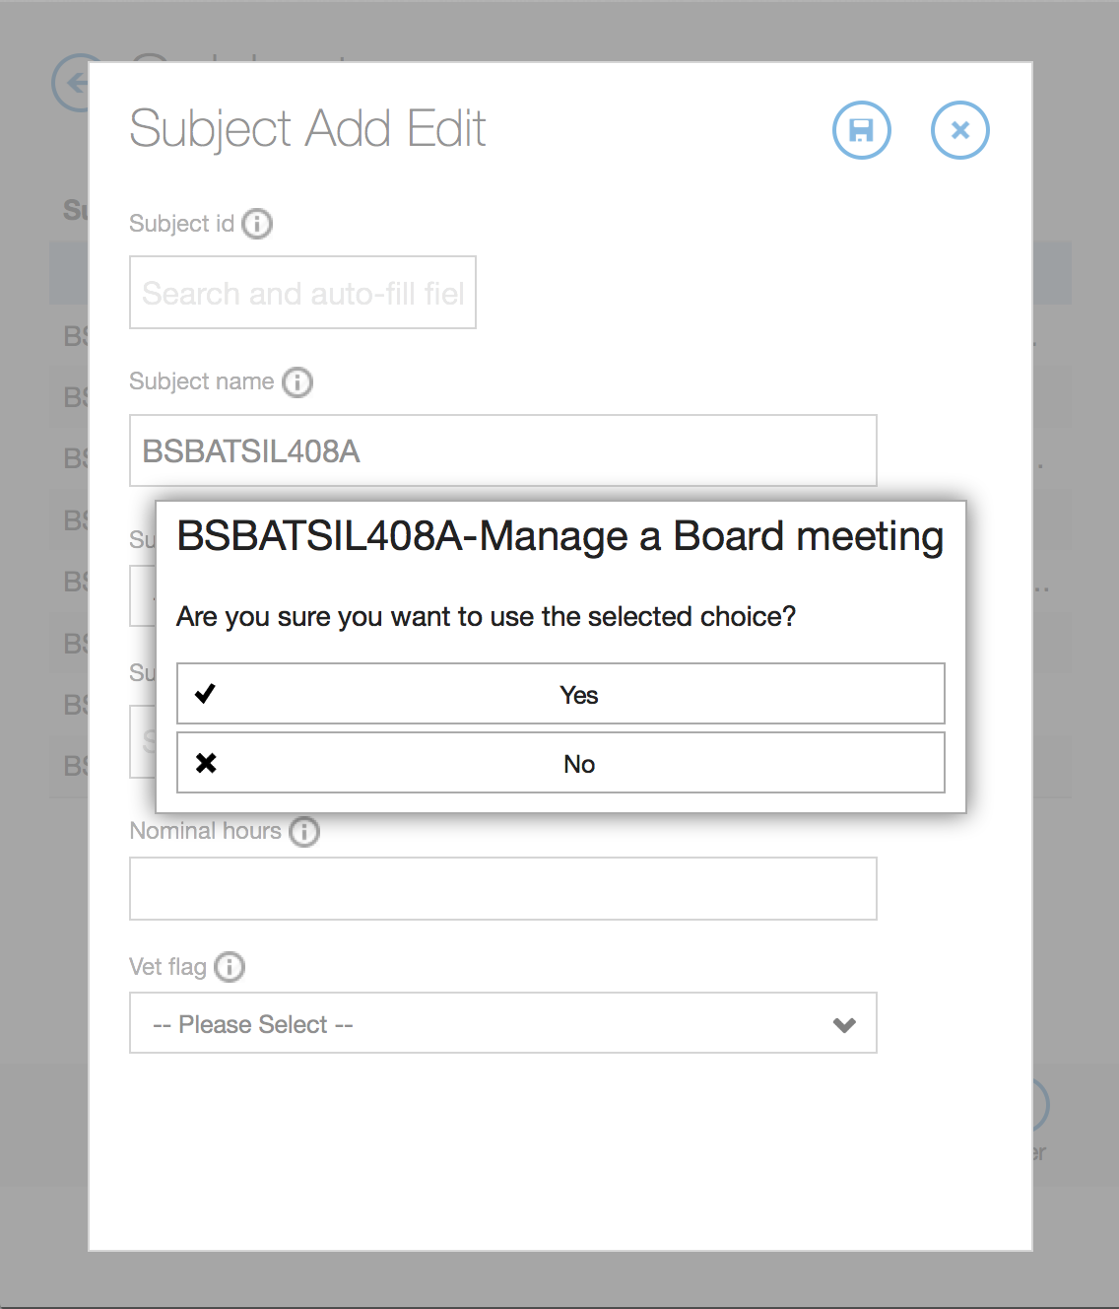
Start typing and suggestions will show up matching your search term.
Confirmation on selecting 1 from suggestions list.
Select 1 from the suggestions list.

Slide 9
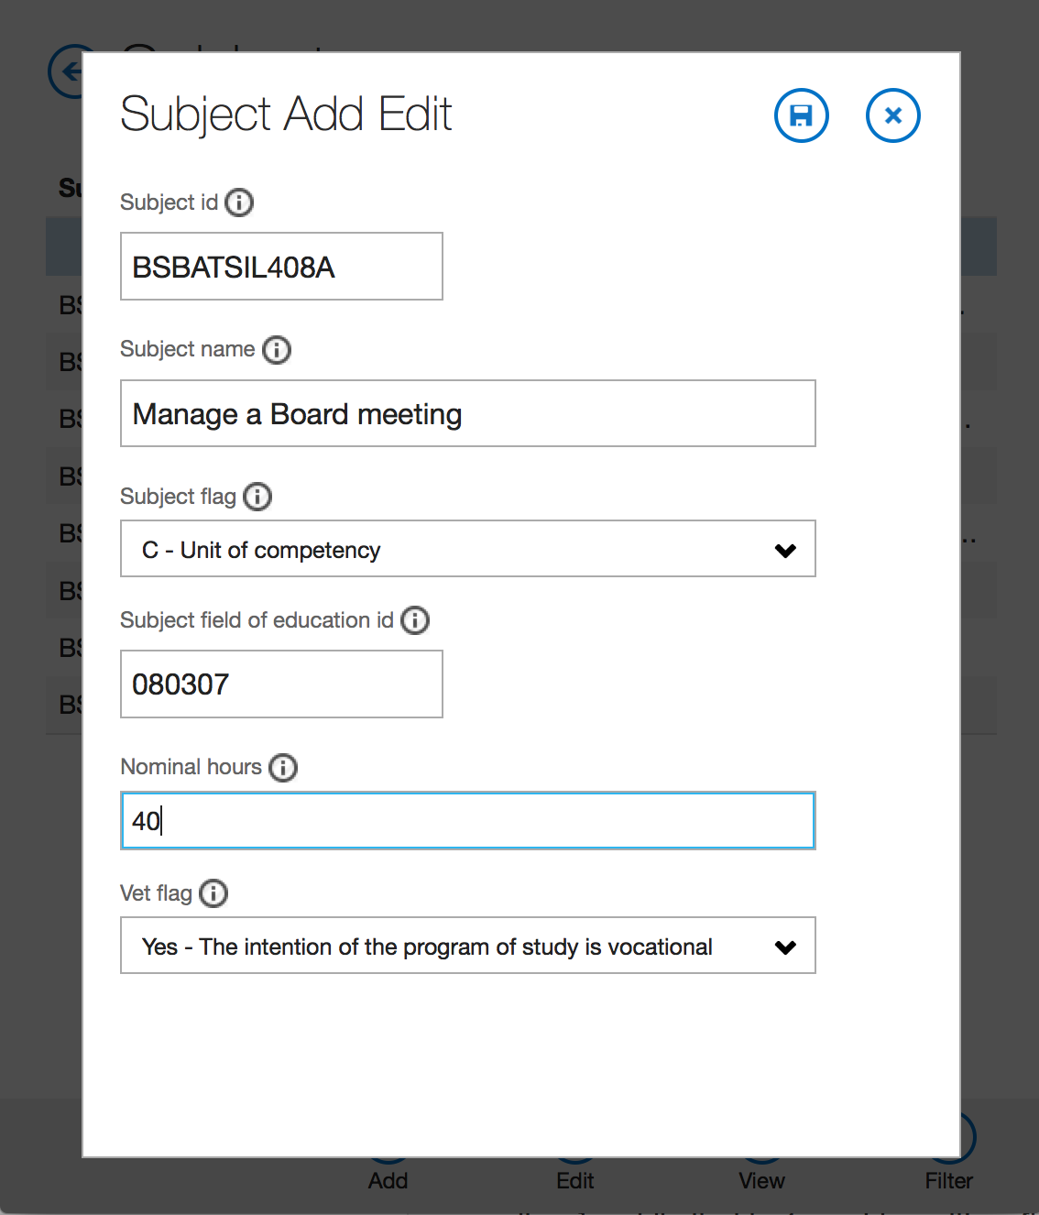
Hit Save Button
Ta Da !! The form is auto-completed for you based on the choice you selected in suggestions list

Slide 10
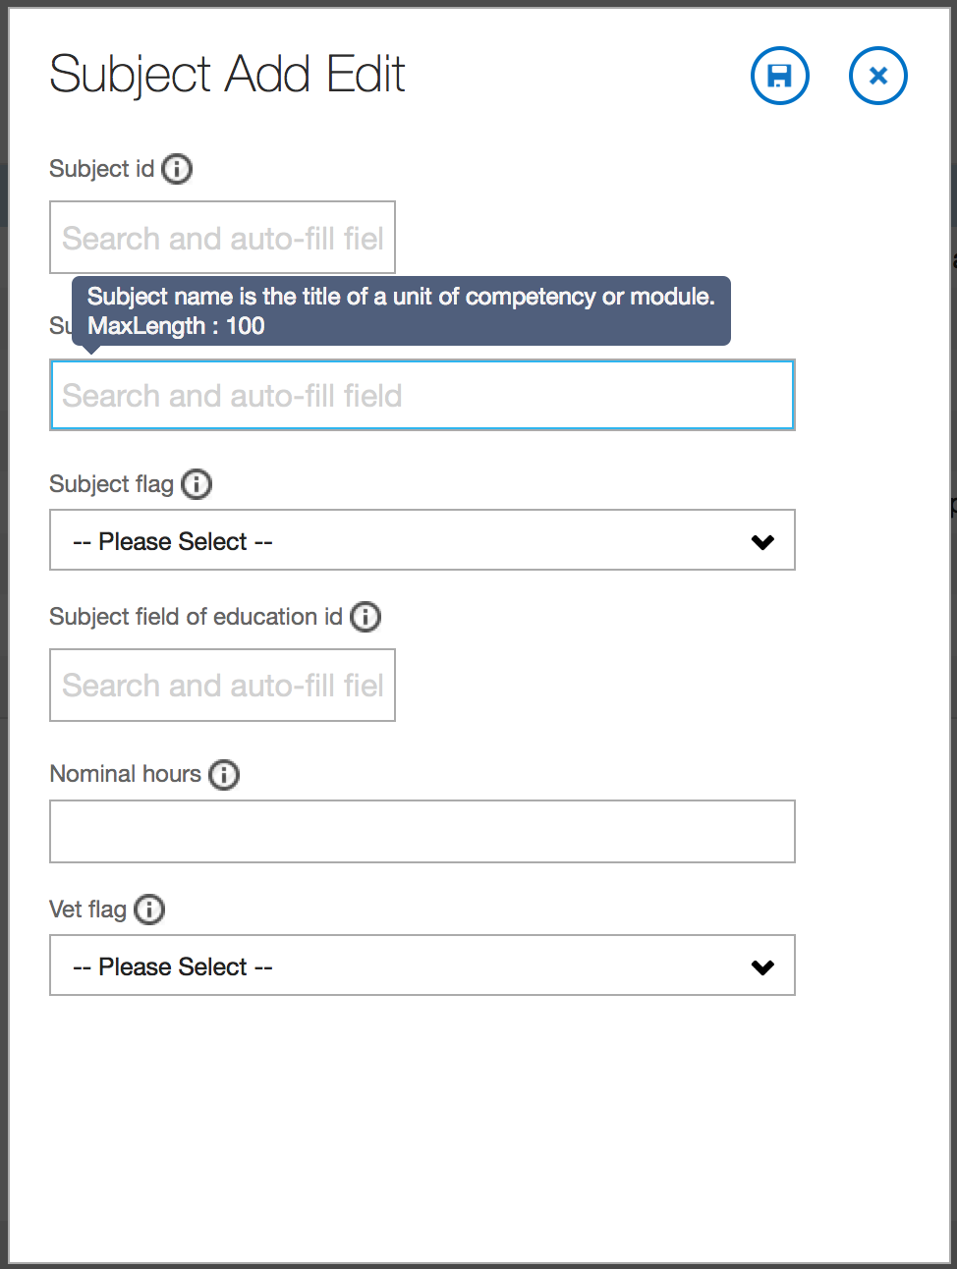

Slide 11
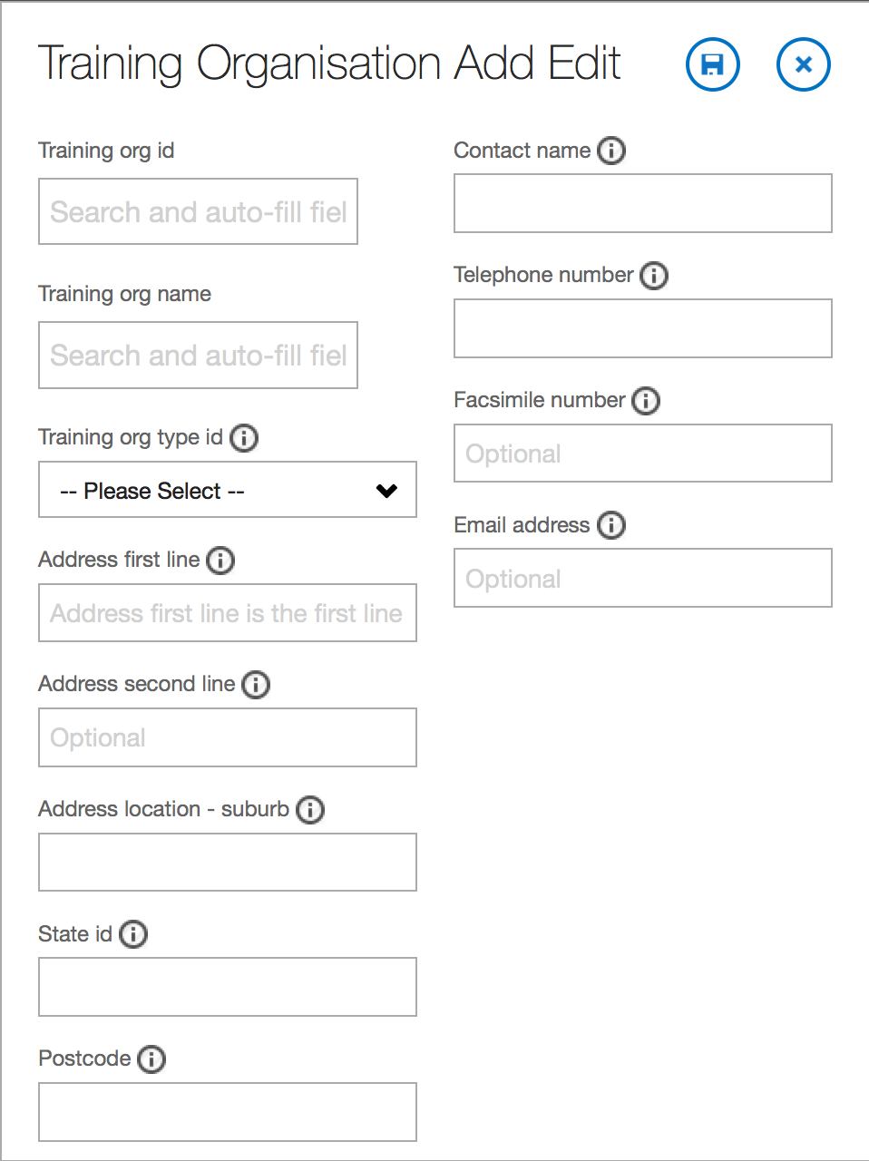
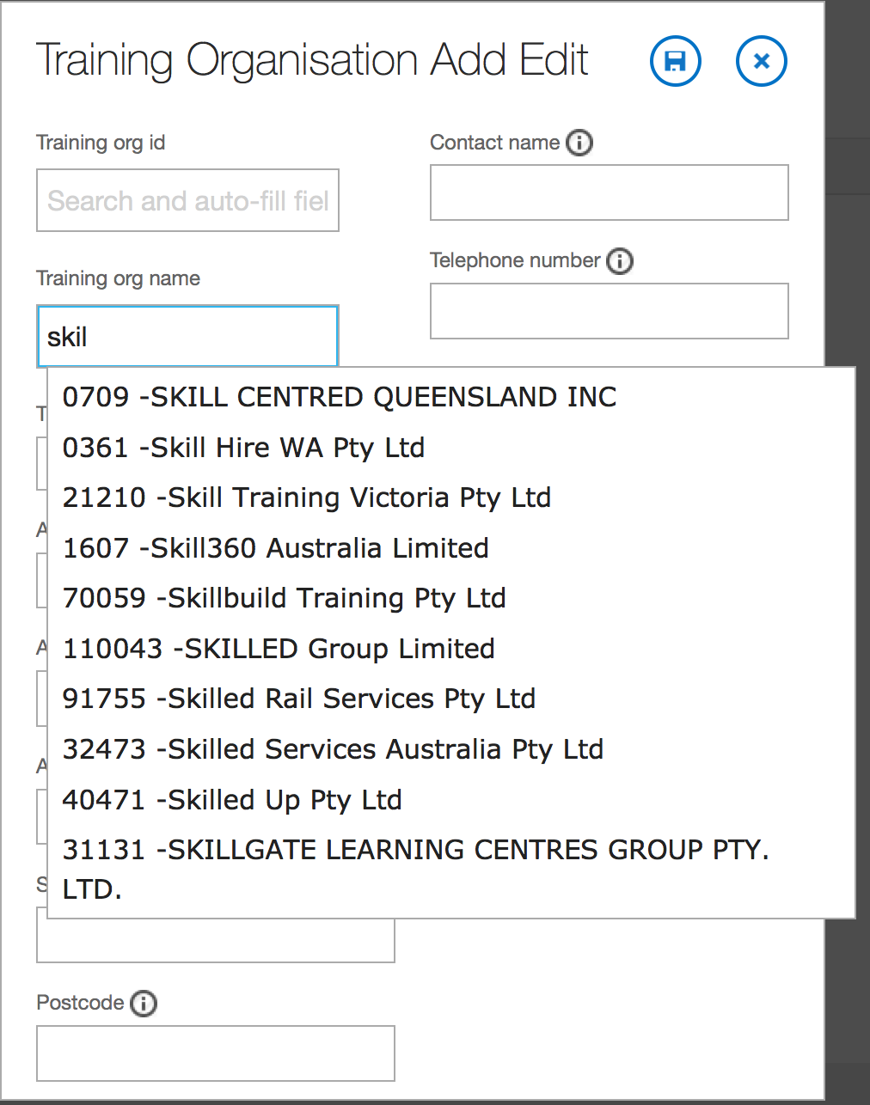

Slide 12
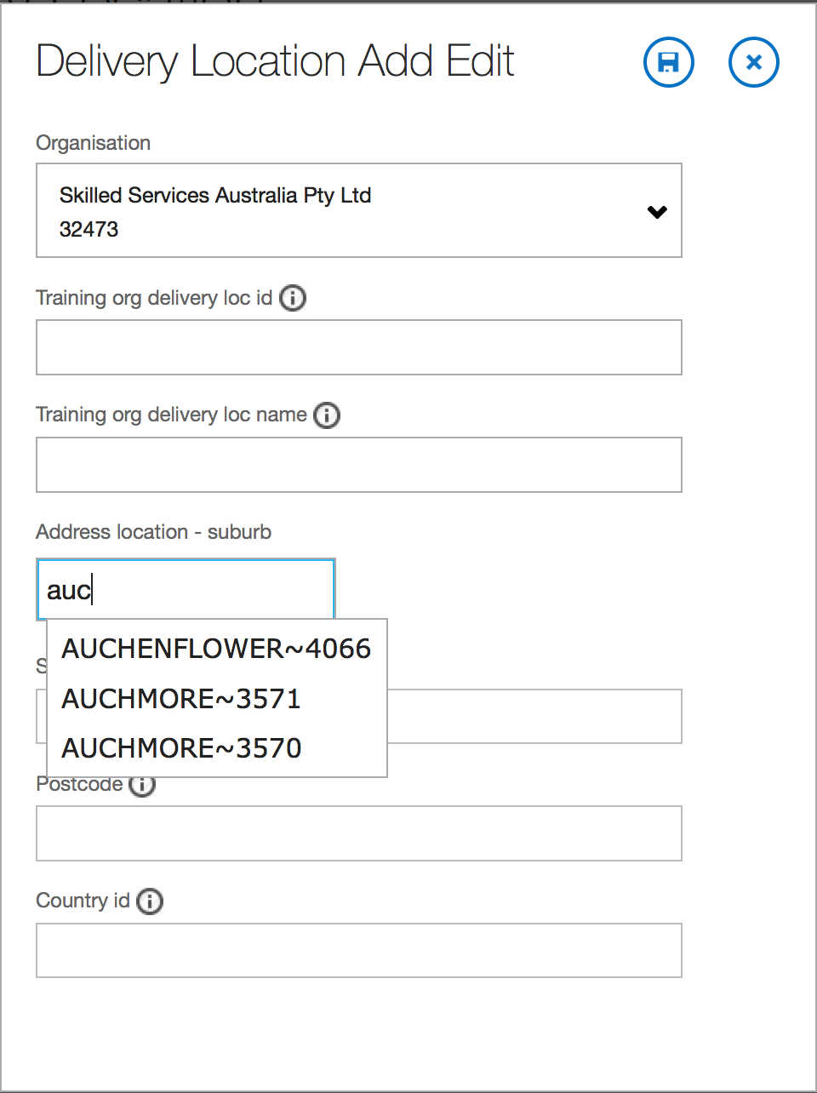
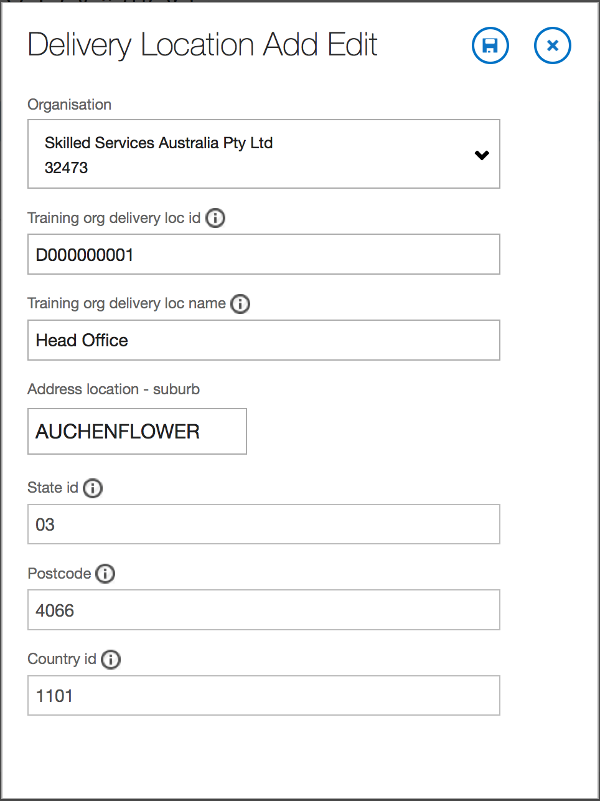

Slide 13
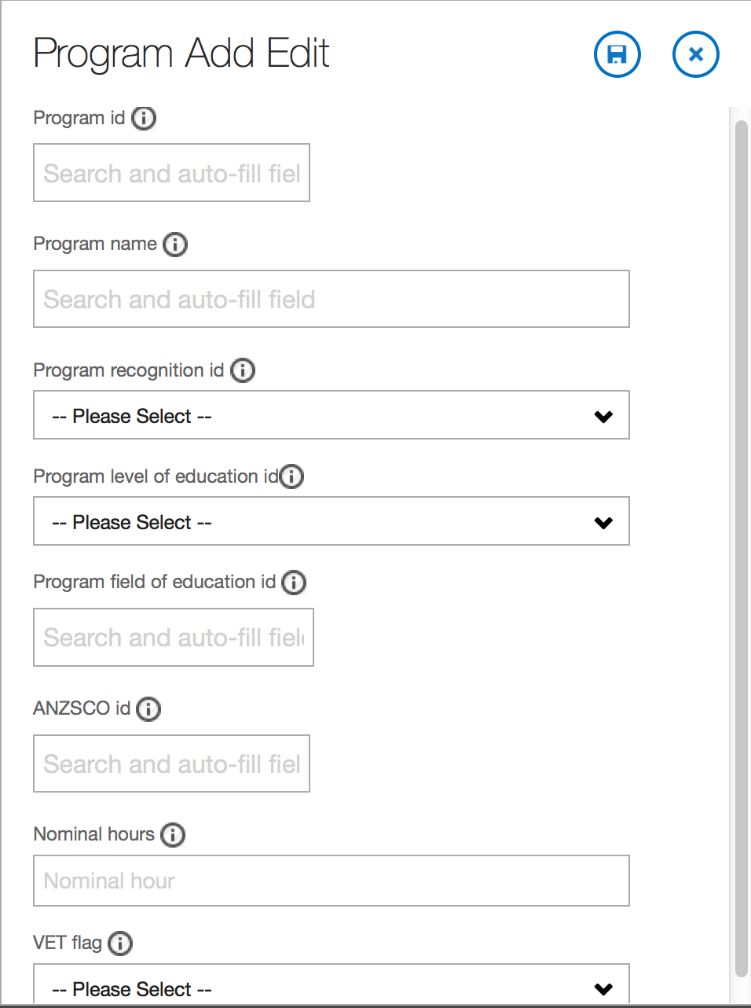
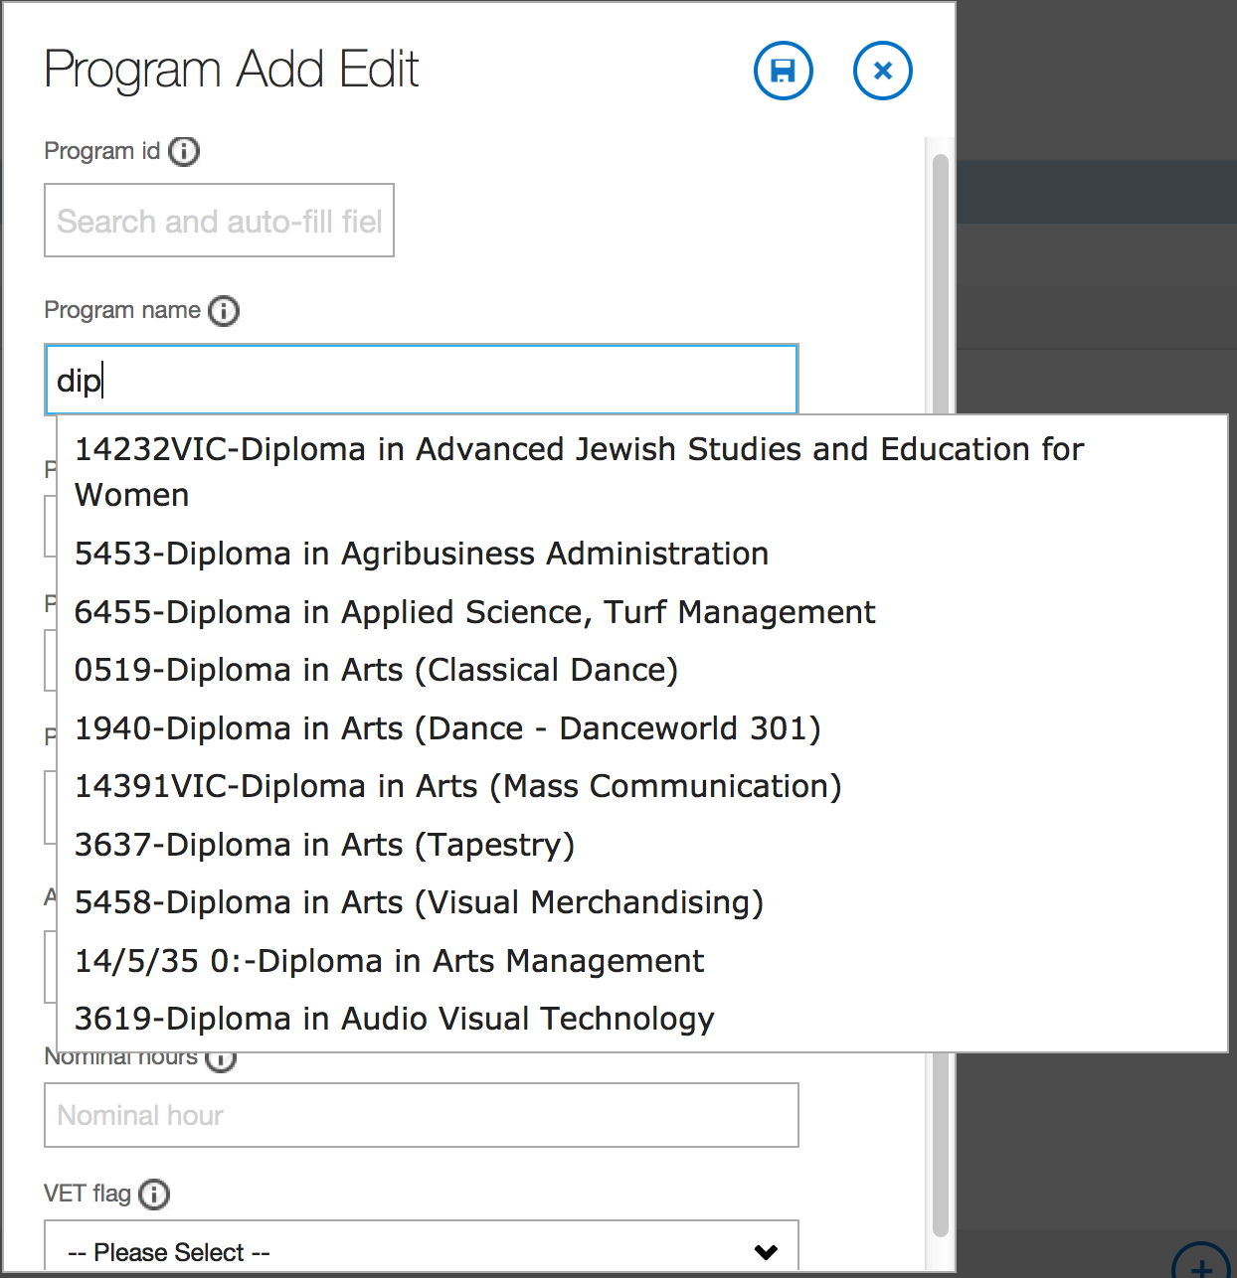

Slide 14
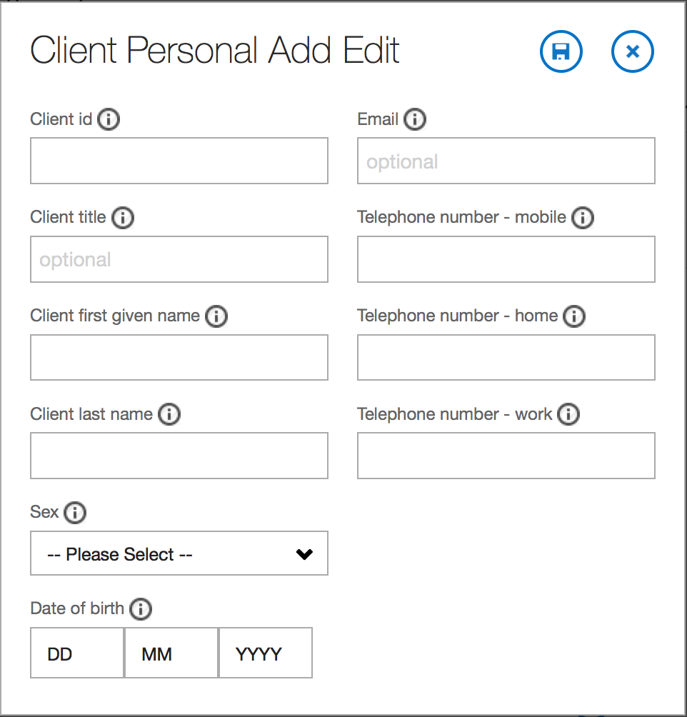
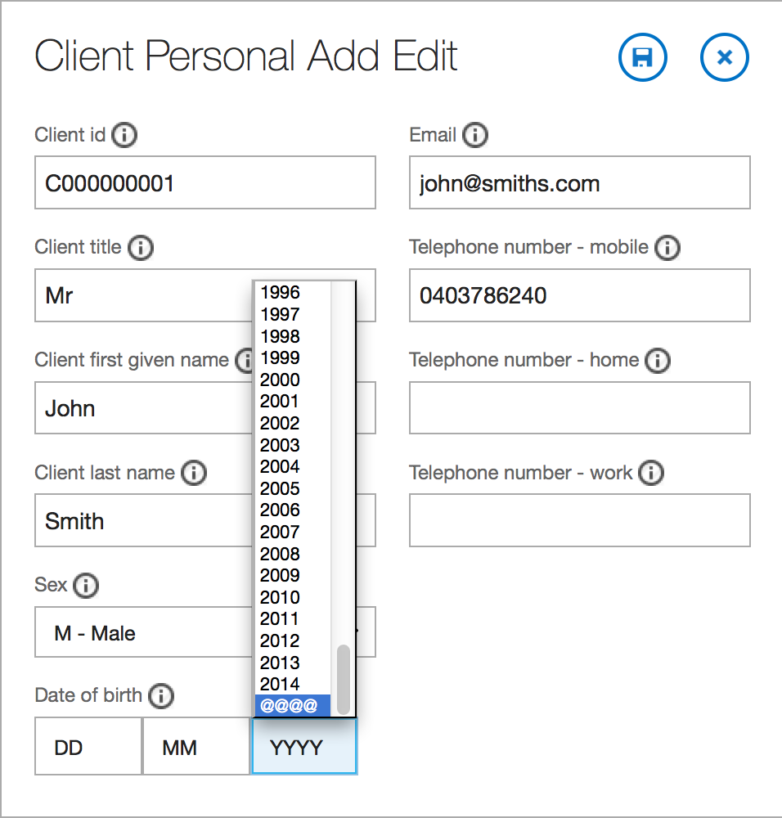
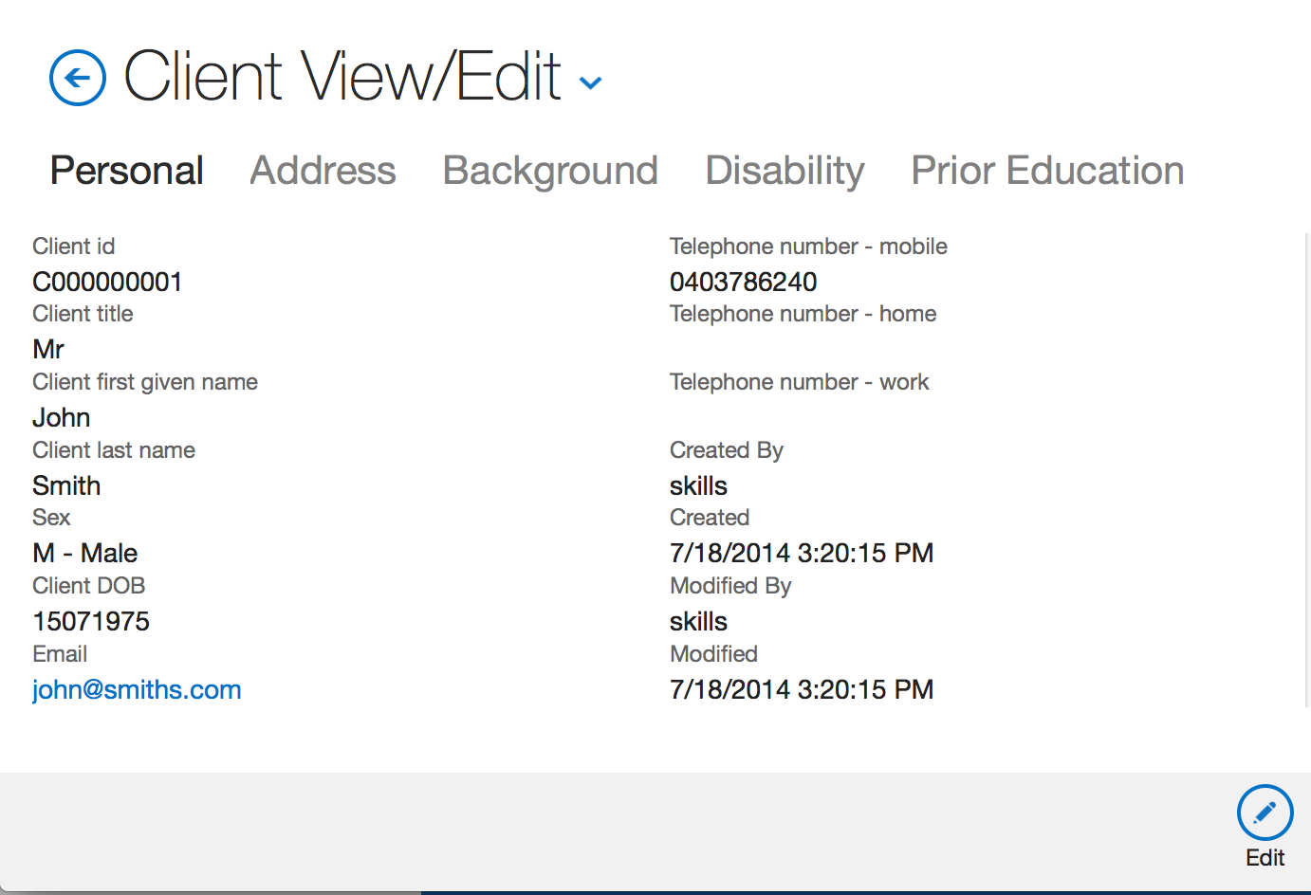
Fill the form and hit save
Only 1 telephone number is required out of the 3 numbers.
‘@@’ for DD and MM
‘@@@@’ for YYYY when not specified.
Client ID is unique
On Save, this screen shows up.
Click on the tabs to enter Address, Background, Disability and Prior Education data about the client.

Slide 15
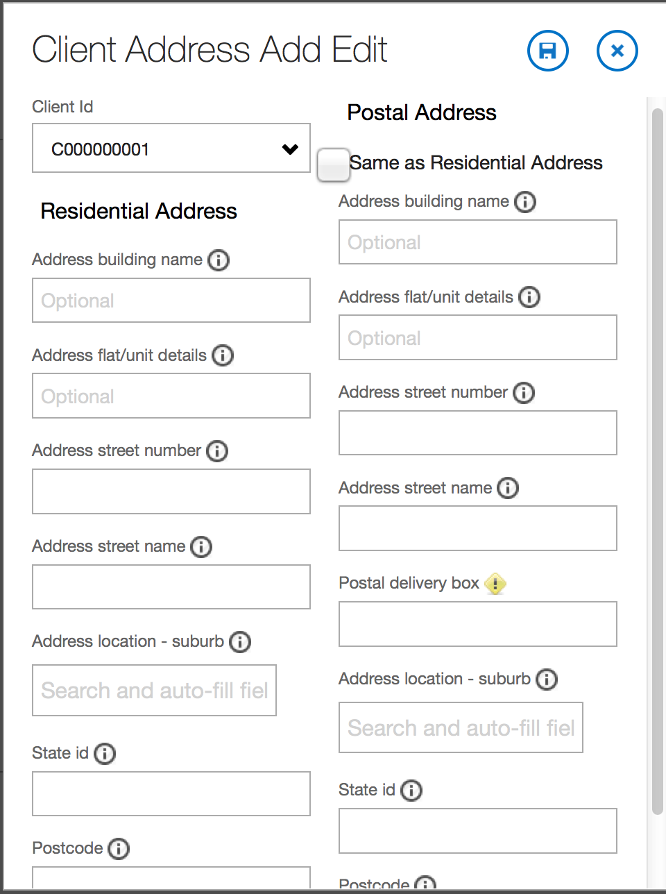
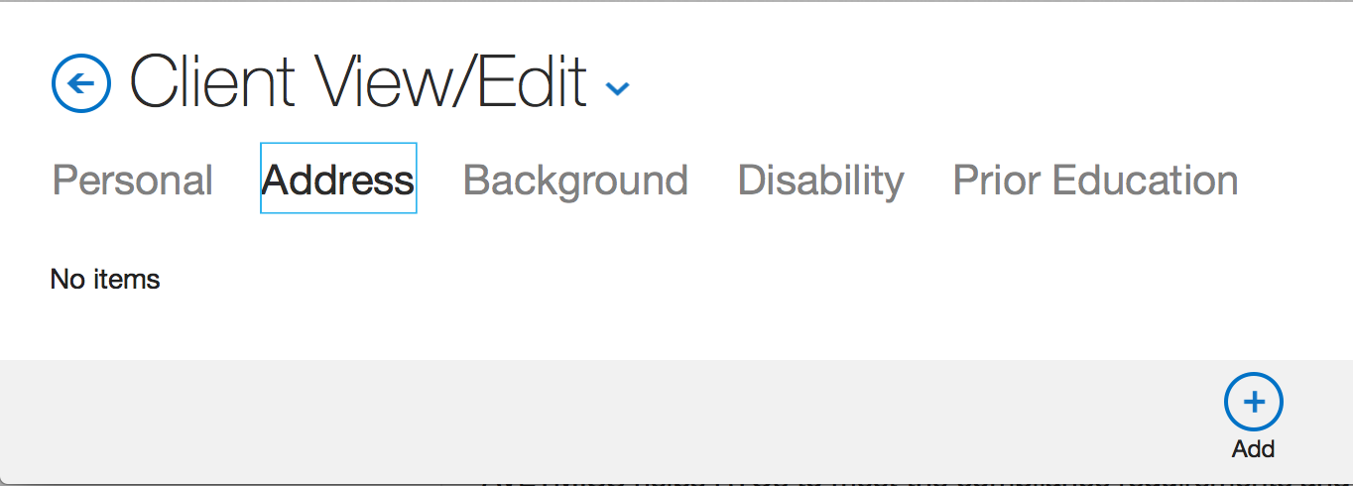

Slide 16
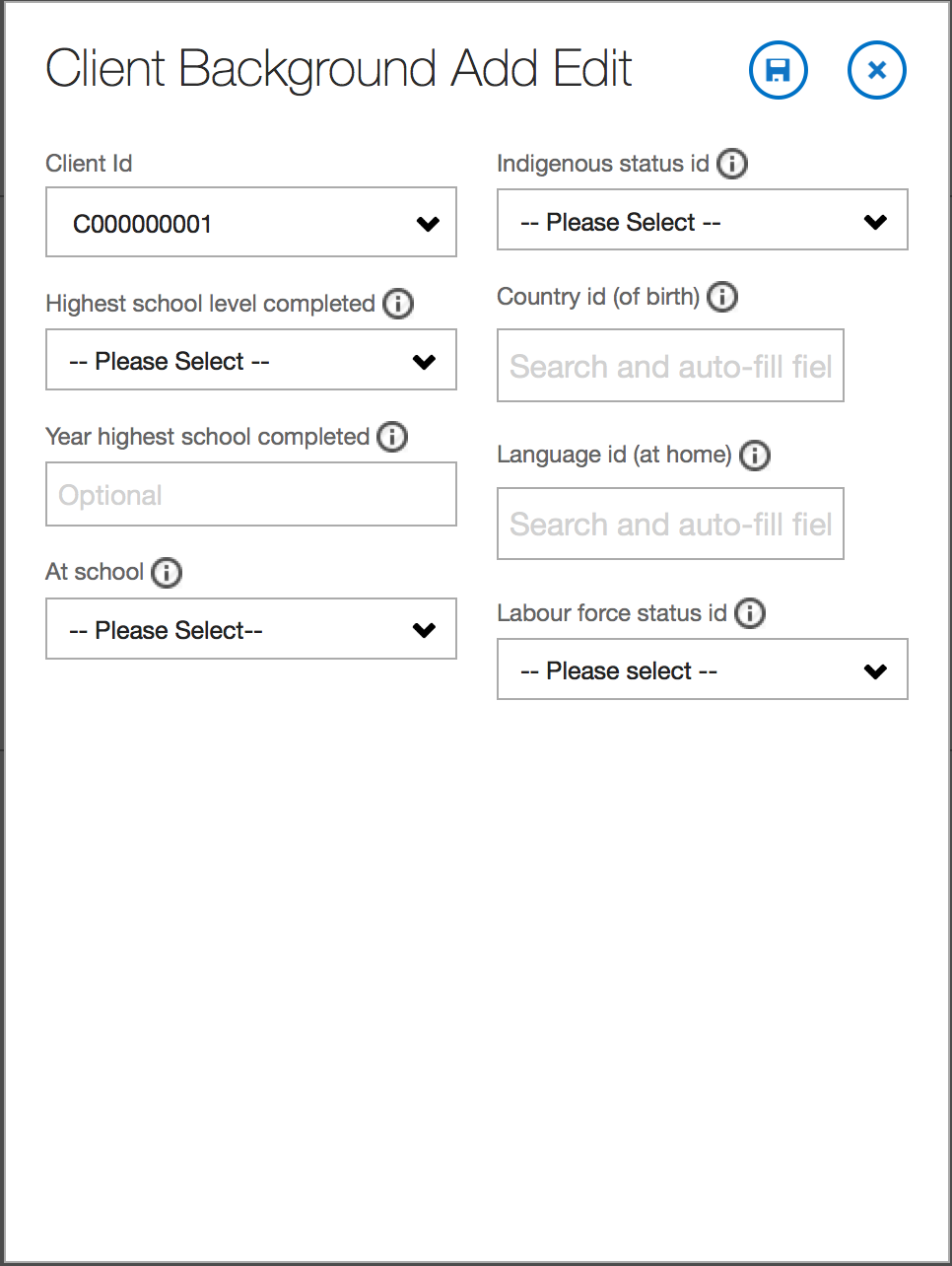
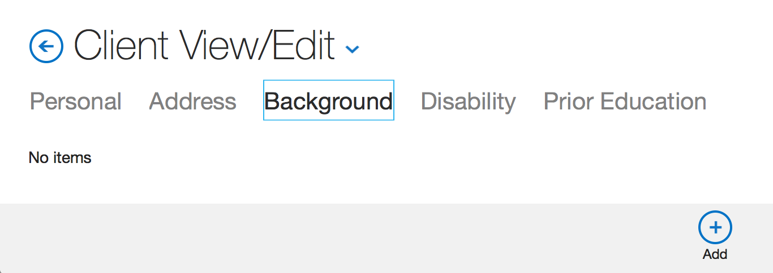

Slide 17
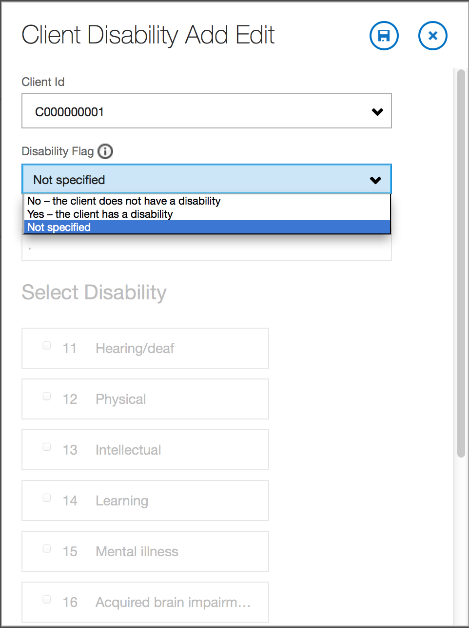
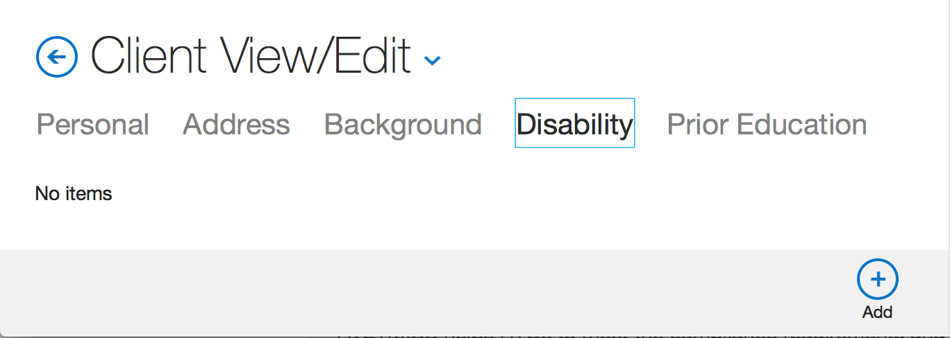

Slide 18
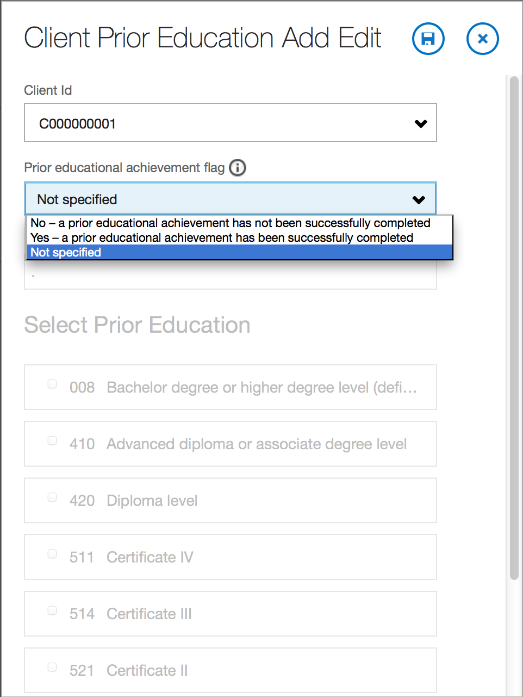
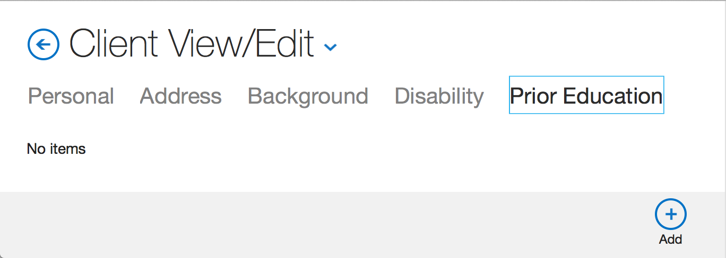

Slide 19
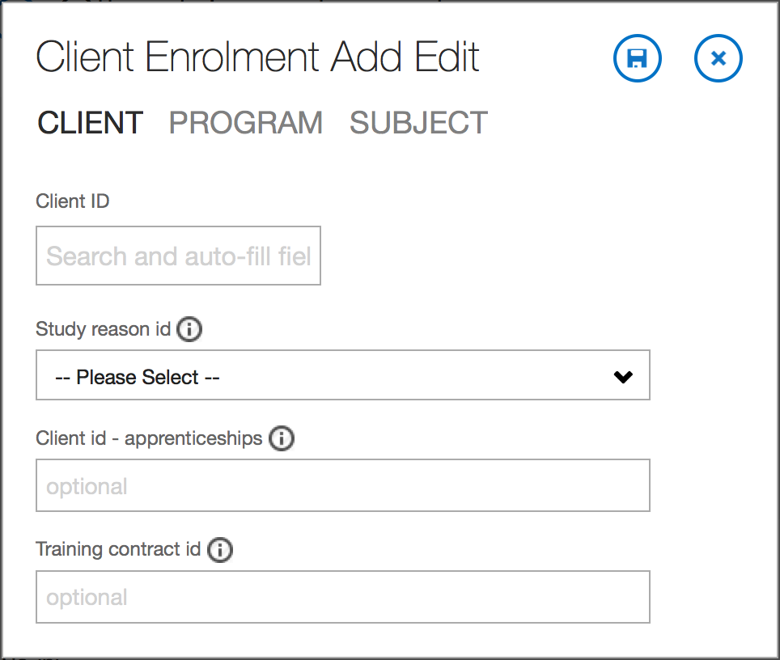
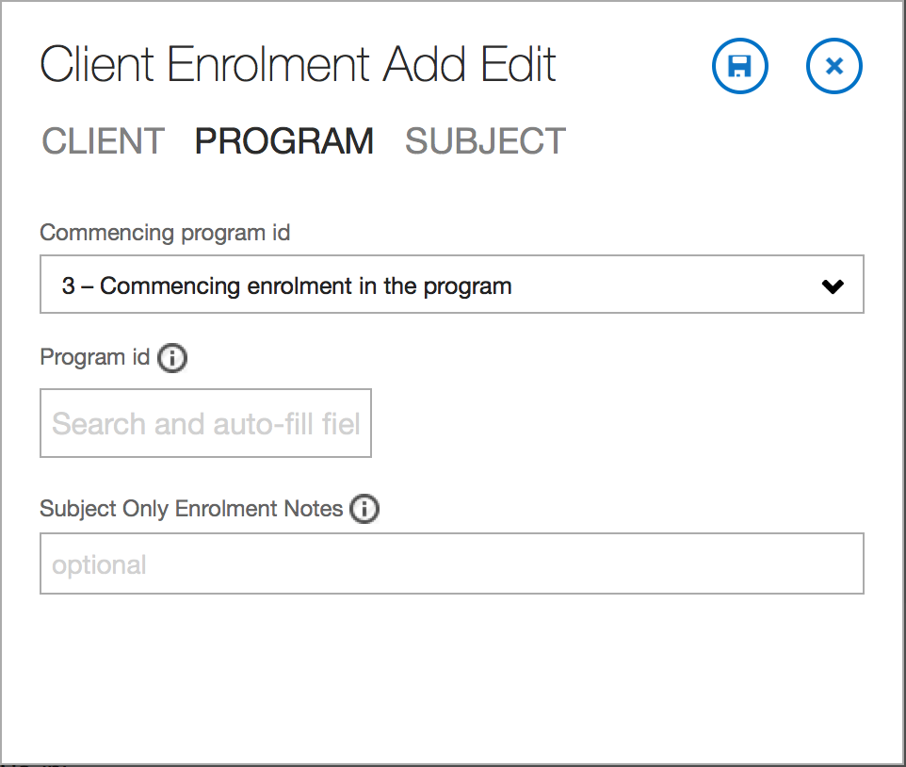
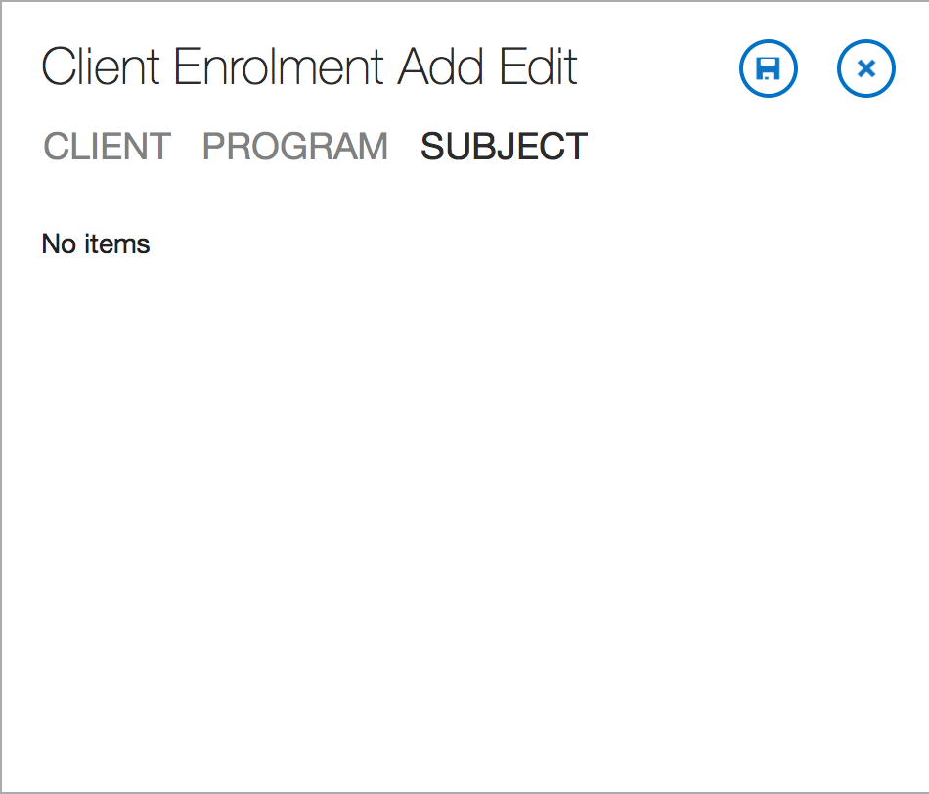
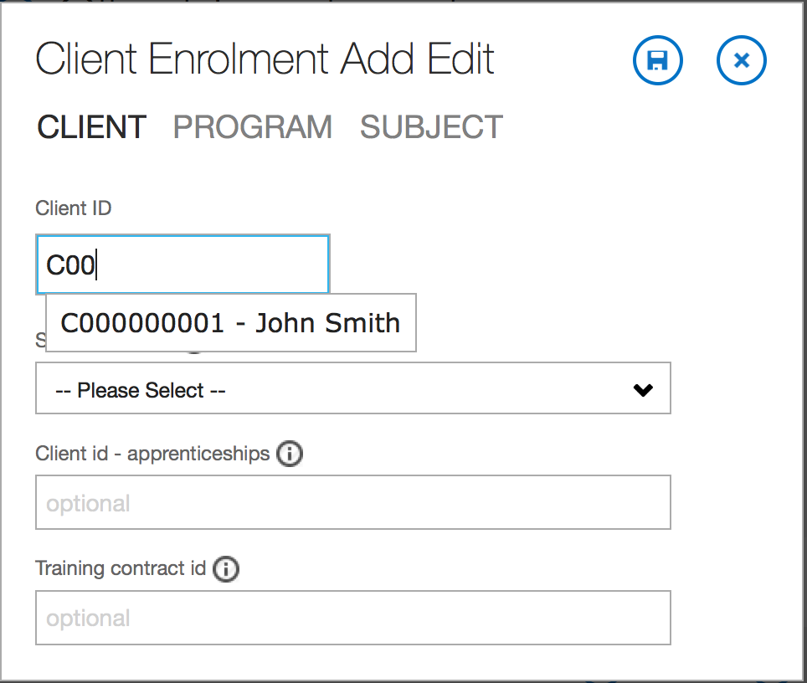
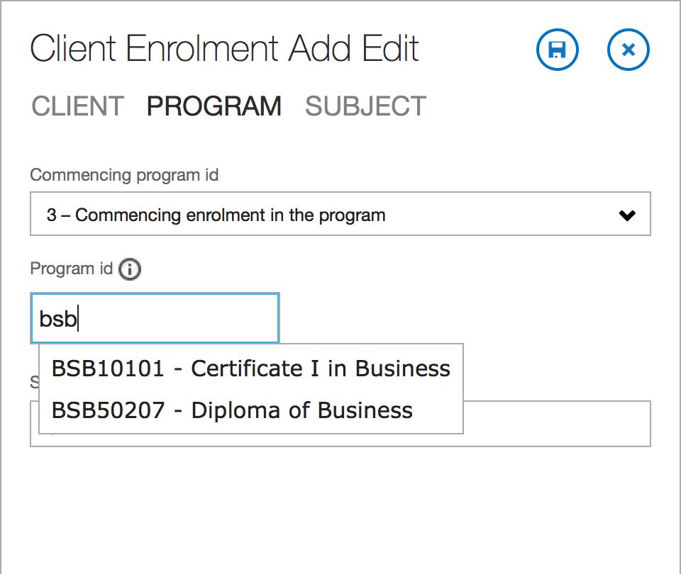
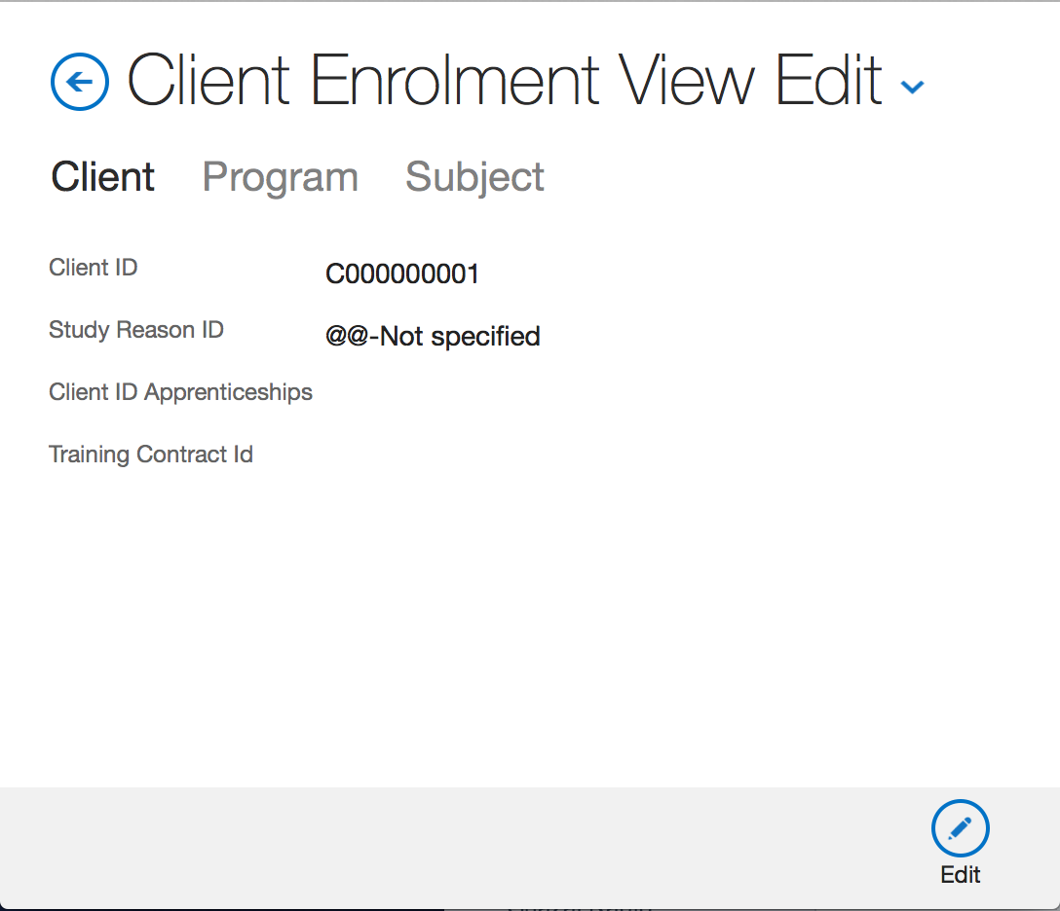
Tabs
Note : Subject tab is Read-Only here. Check the image below to see how subjects are created
On save, this screen shows up
Now click ‘Subject tab’
Fill ‘Client tab’ fields and click Program tab
Fill ‘Program tab’ fields and hit save

Slide 20
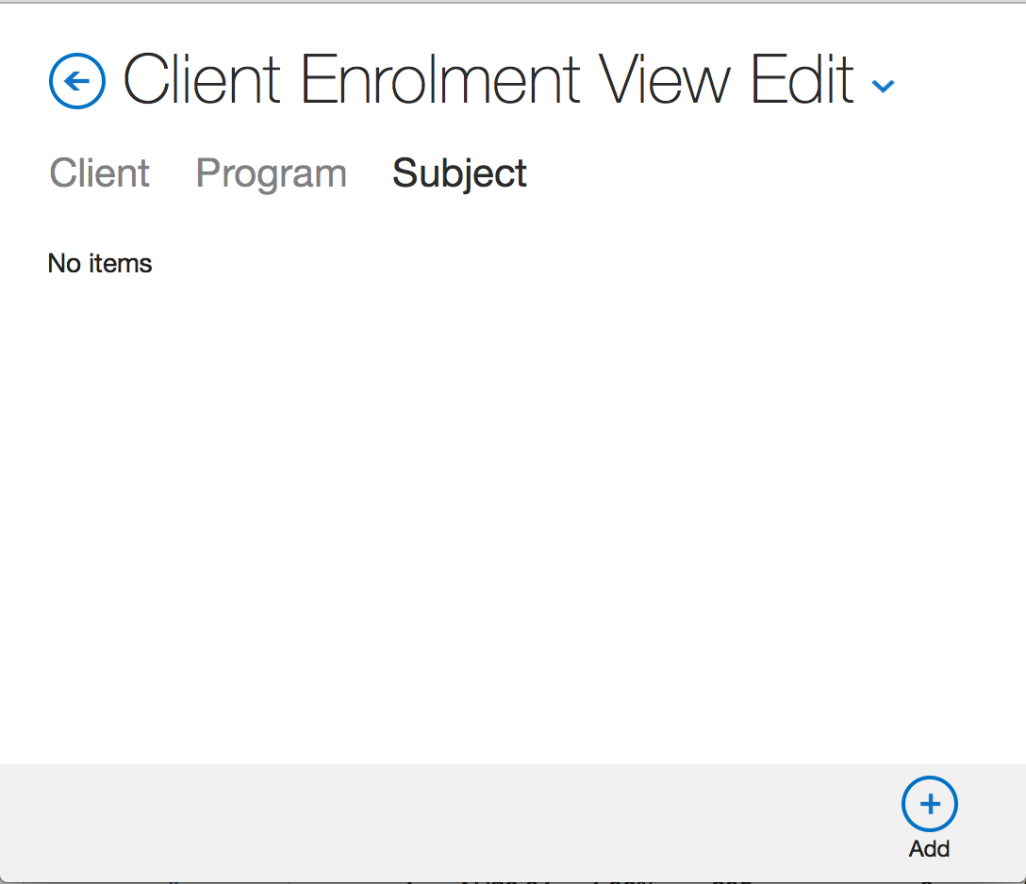
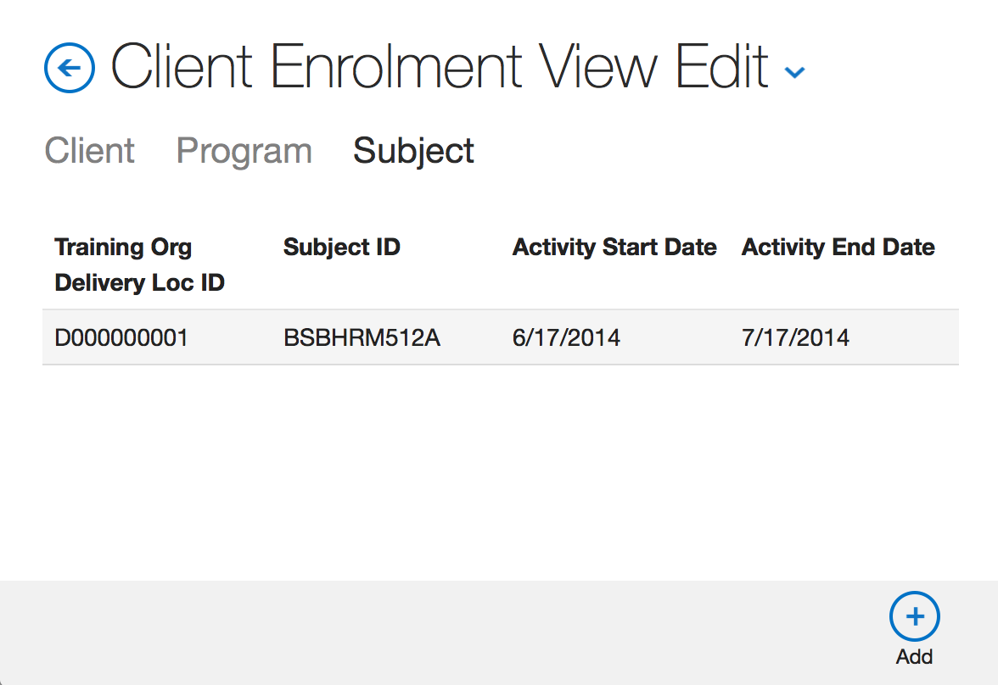
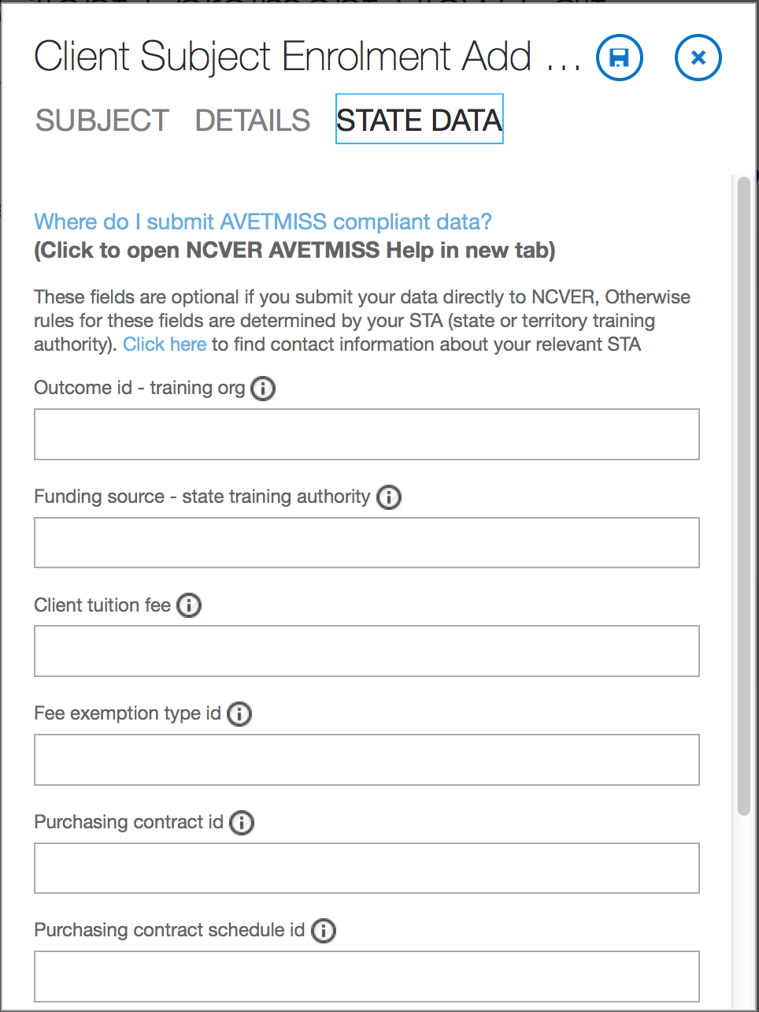
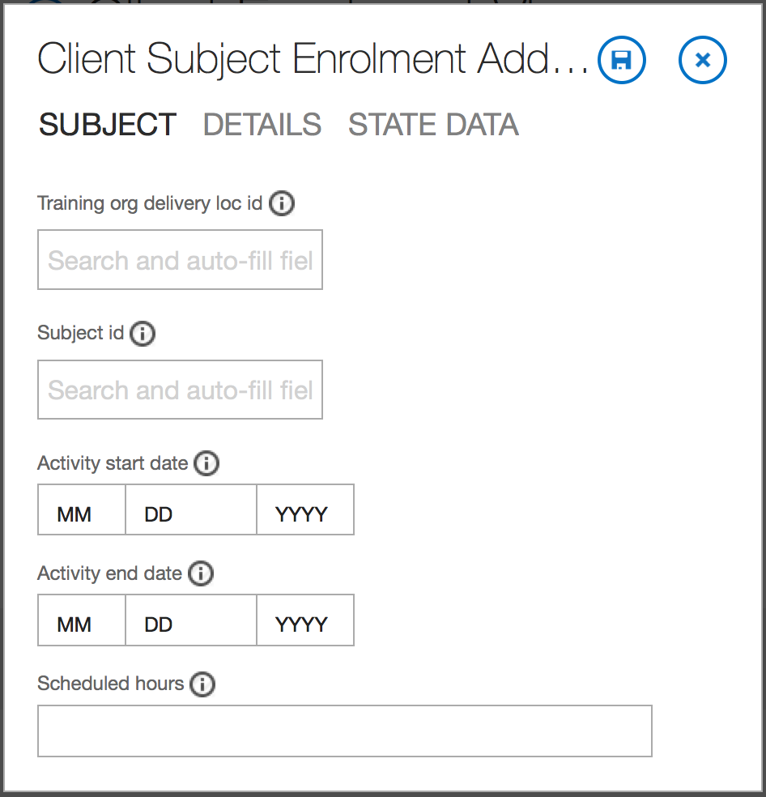
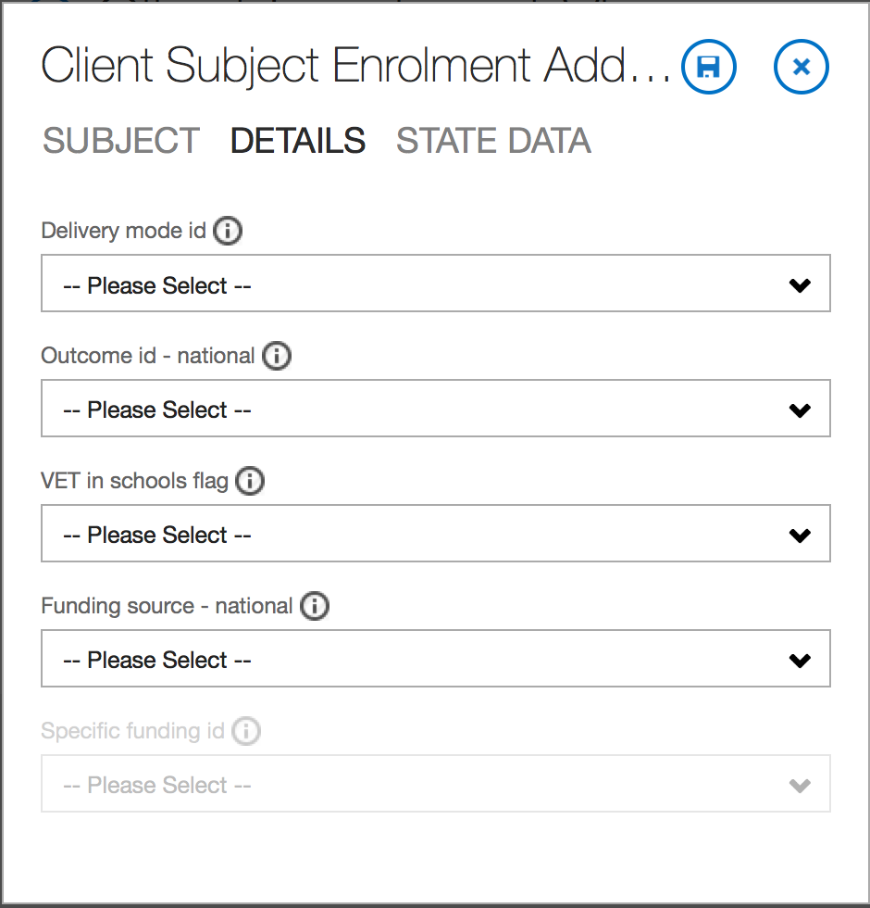
This screen shows up on saving subject. Add more subject records if needed
Fill ‘Details tab’ fields and click ‘State Data tab’
Fill ‘State Data tab’ fields and click Save
Fill ‘Subject tab’ fields and click ‘Details tab’

Slide 21
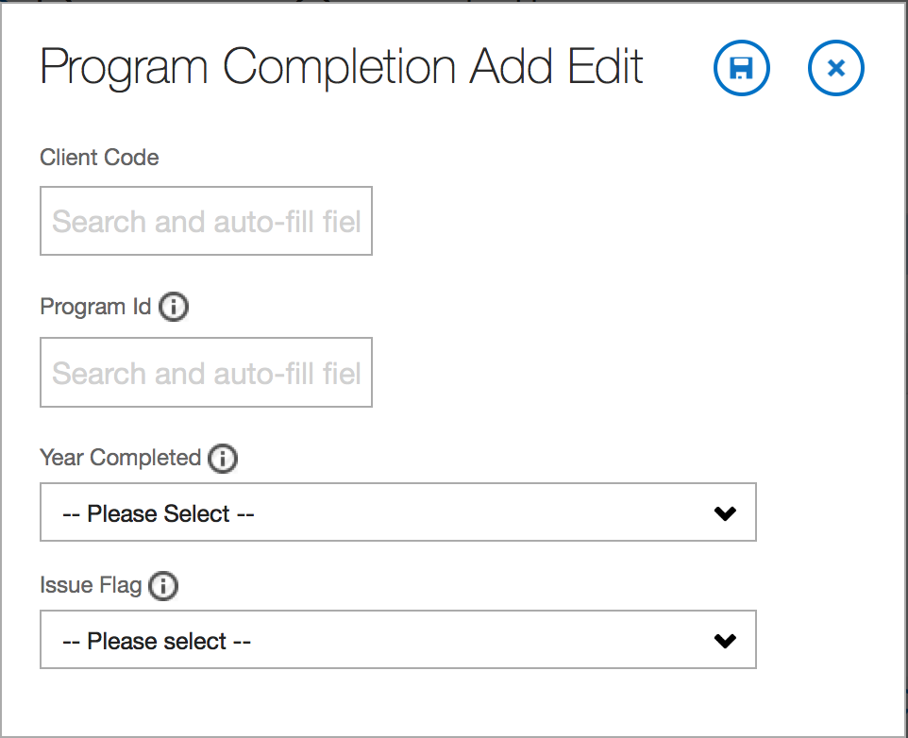
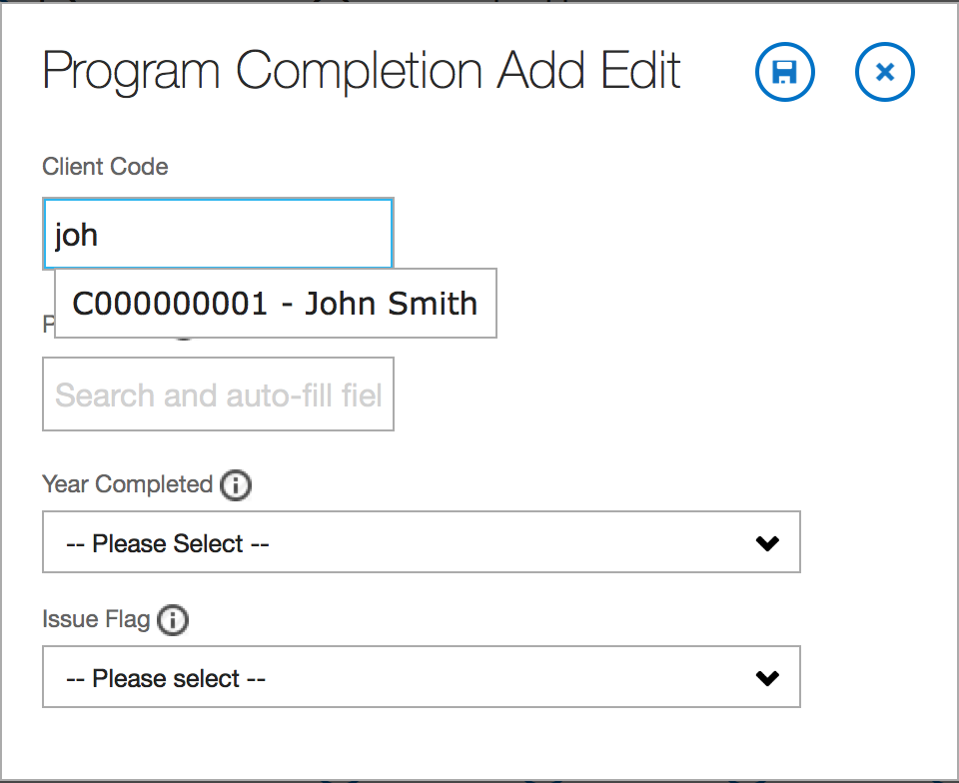
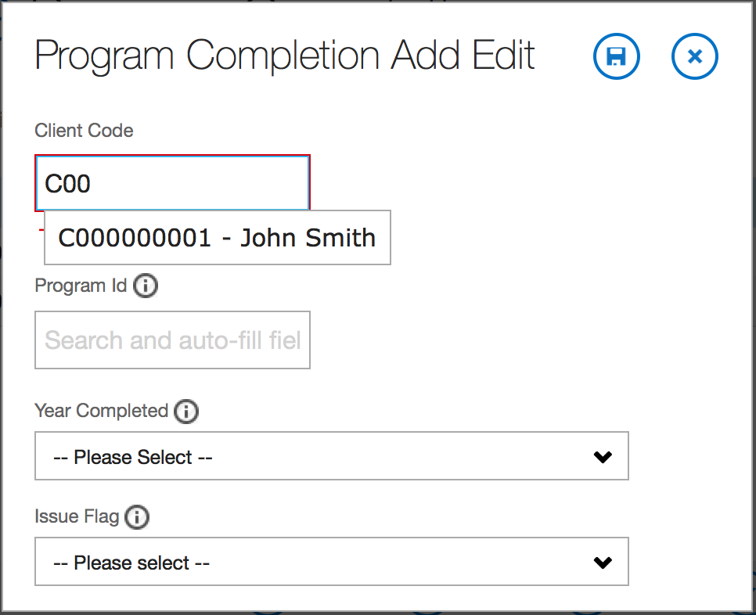
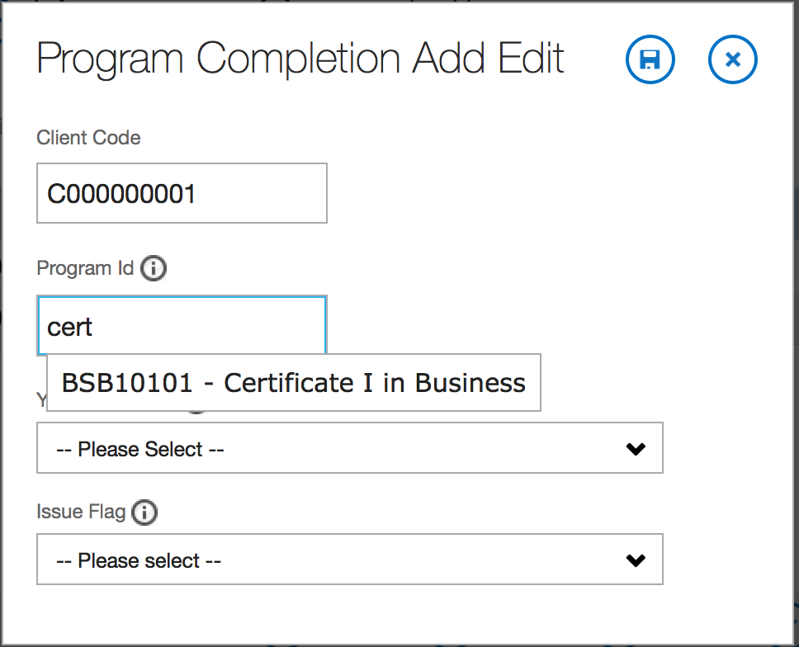
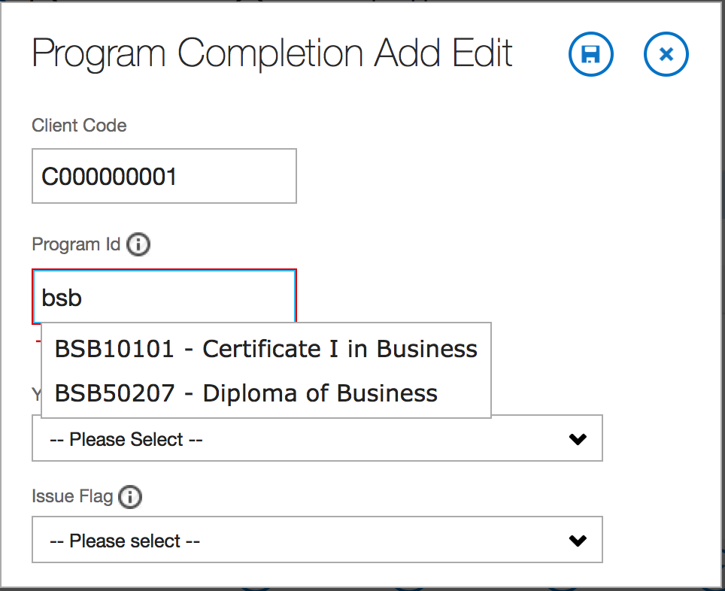
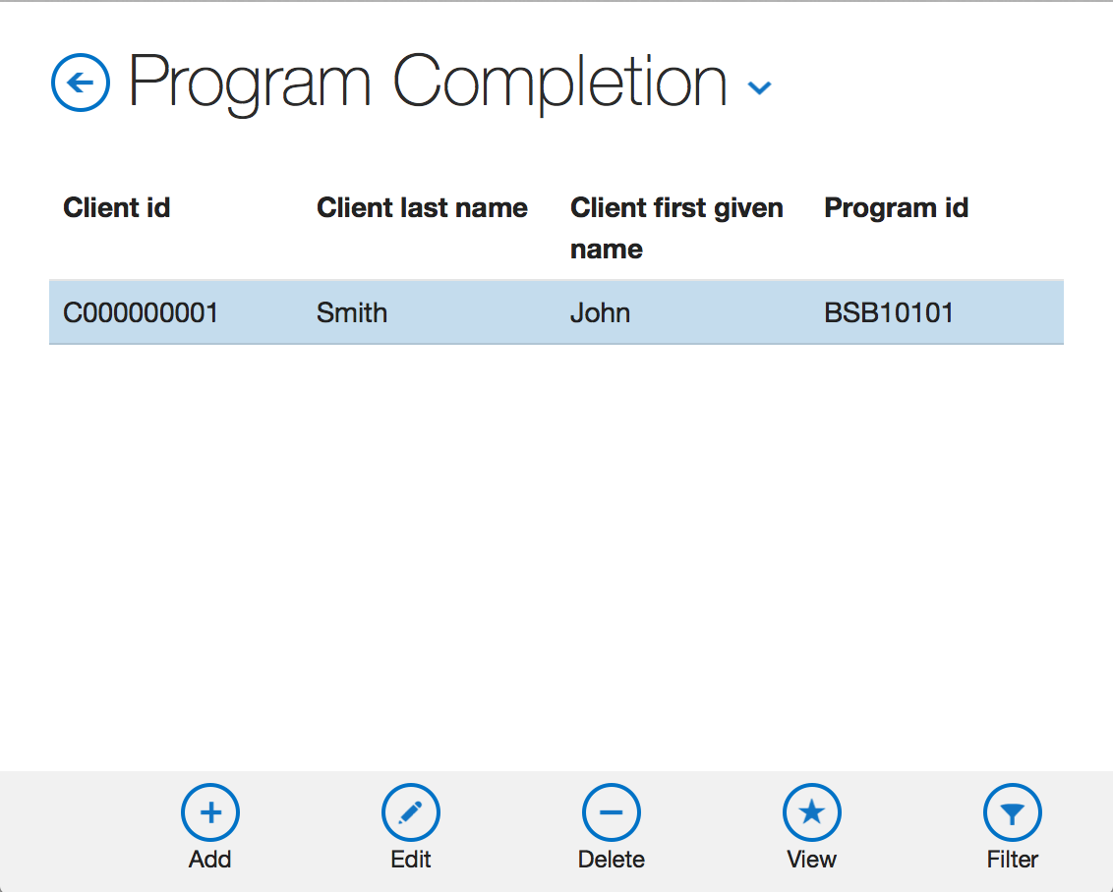
Search existing client by code or name
Search existing program by code or name

Slide 22
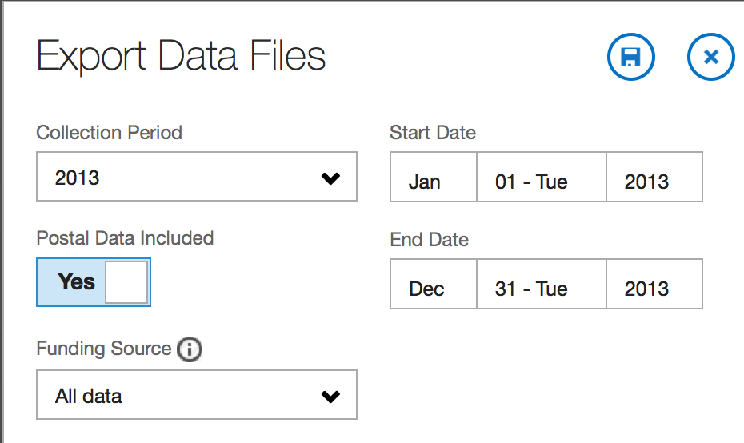
Hit Save to start Export process
Sets start and end date.
You can manually change the start & end date

Slide 23
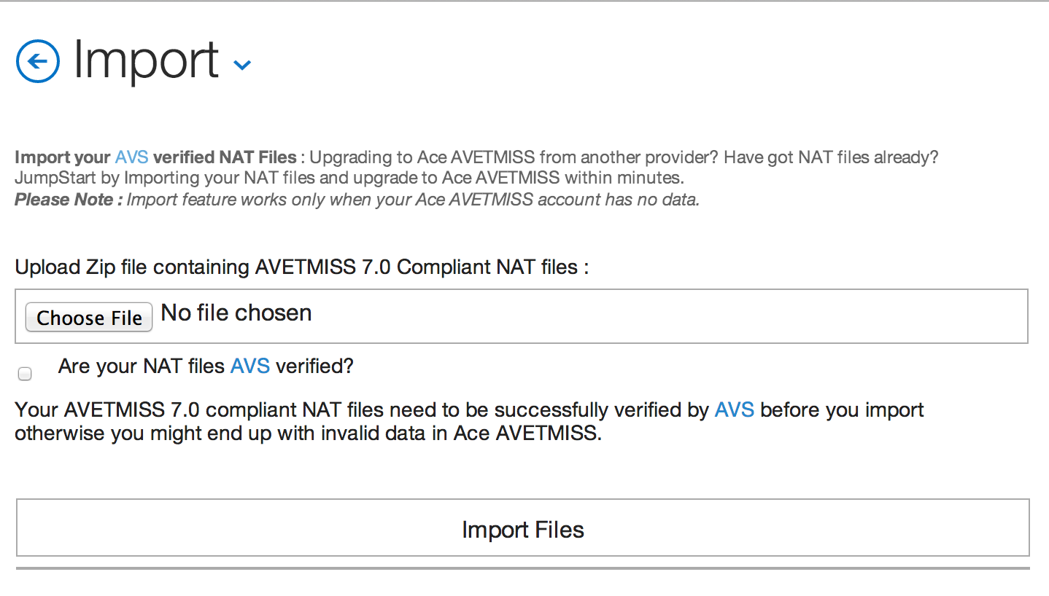
Create a Zip folder with AVS verified NAT files. Please verify the filenames should match exactly as shown in the image. Upload the folder, check the checkbox and hit ‘Import Files’ button to start import process.
If your Ace Avetmiss account has data, then you will not be able to Import. You can delete all you data using the ‘Delete All Data’ button. Once your data is deleted, you will be able to import.

